Slide 1
The Pillars of APT Defense March 23, 2017
M. E. Kabay, PhD, CISSP-ISSMP
Professor of Computer Information Systems
Department of Computing
School of Business & Management
College of Professional Schools
Norwich University

Slide 2
Topics
What are APTs?
Fundamental Difficulties for IA Statistics
Examples of Publicized APTs
Perimeter Defenses
Human Defenses
SIEM
Incident Response
Business Continuity

Slide 3
What are APTs?
Advanced persistent threats
Long-term undetected access to systems
Usually associated with data leakage
Unauthorized access to confidential information
E.g., strategic planning, mission-critical data, competitive-positioning information
May be used for sabotage
Unauthorized use of resources (e.g., botnet activity)
Data corruption
Data deletion
Denial of service

Slide 4
Fundamental Difficulties for IA Statistics
Ascertainment
May not detect problem at all
May detect attack only after it’s succeeded
Documentation
Victims may maintain secrecy
Concerned about strategic consequences
Damage to reputation
Loss of credibility
Legal penalties
Laws changing
Some requirements for disclosure; e.g., compromised PII*
*PII = personally identifiable information

Slide 5
Examples of Publicized APTs
Titan Rain (2003) – Chinese hackers vs US govt
Sykipot (2006) – spear-phishing using malware
GhostNet (2009) – Chinese INFOWAR for intel
Stuxnet (2010) – US/Israeli attack on Iranian Siemens centrifuge controllers
Deep Panda (2015) – China vs US Office of Personnel Management – 4M people’s records
Poison Ivy RAT (2016) – FBI reported ATP6 group infiltrated US govt systems since 2011

Slide 6
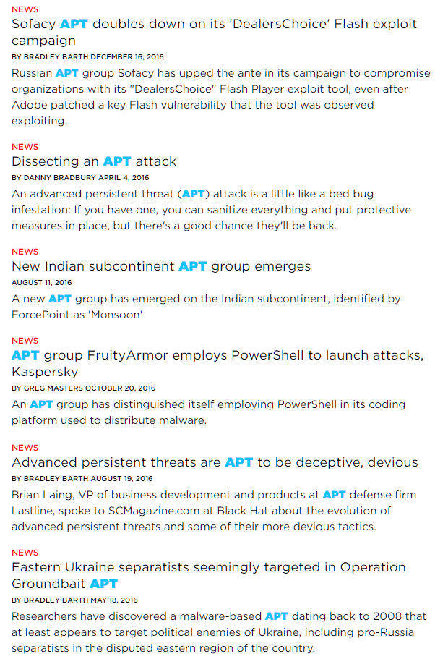
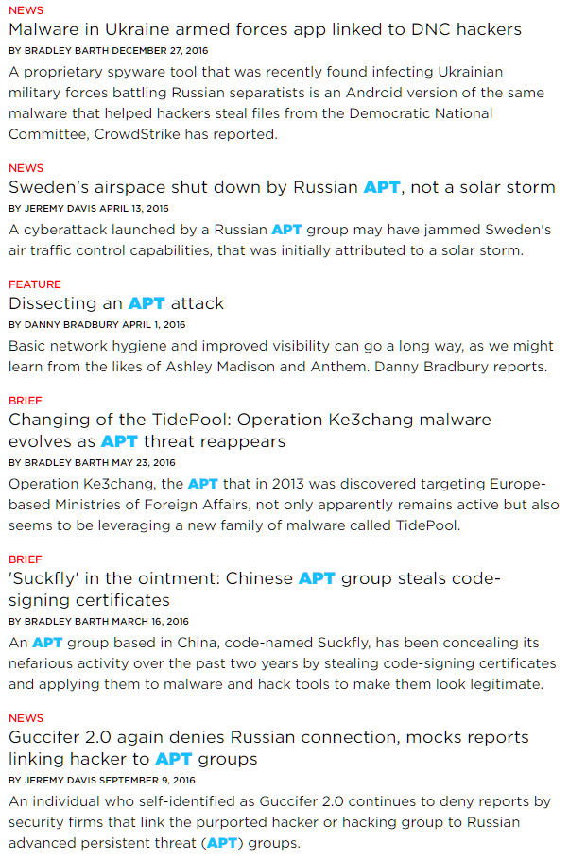
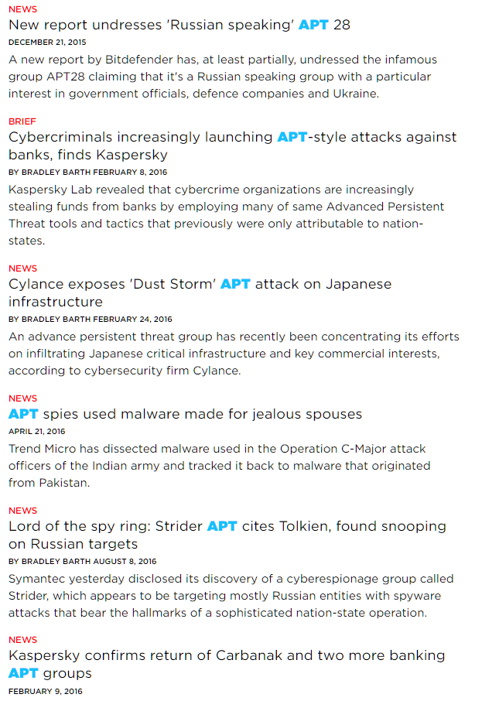
(SC Magazine Reports)

Slide 7
1. Perimeter Defenses
First principle: DON’T LET THE MALWARE IN!
Anti-malware software & hardware
Firewalls
Integrated perimeter defenses
Real-time updates

Slide 8
2. Human Defenses
Employee awareness critically important
Majority of APTs inserted through human error
Phishing
Pharming
Social engineering (“lost” flash drives)
Security awareness depends on involvement
Stress importance to individuals & to their groups
Provide information they can share with family & friends
Increases cooperation by changing self-perception
Provide constant friendly challenges & rewards
Avoid negativity – stress positive environment

Slide 9
3. SIEM
Security Information & Event Management
AKA cyber-situational awareness
Monitor system & network activity in known-safe, normal uncompromised environment
MUST NOT USE COMPROMISED SYSTEM AS BASELINE
Define whitelist of acceptable interactions
Monitor all activity in real time
Identify deviations from whitelist
If acceptable, update whitelist
If not, investigate / remove source(s) of anomalous activity

Slide 10
4. Incident Response – Technical
Time has unequal value
Hours spent in planning, practice & refinement may be less expensive than minutes wasted in responding to real incursion
Use operations-management analysis
Identify mission-critical functions
Define critical paths
Set limits to acceptable delays
Plan & practice forensic response
Maintain effective logging strategies
Enable immediate data capture & media sequestration

Slide 11
5. Incident Response – Managerial
Legal team
Know legal responsibilities
Local, state, federal requirements
Clear flowcharts for deciding exactly
what must be done
by when
for whom
Public-relations team
Discuss many different scenarios during planning
Be prepared in advance with written scripts
Know exactly how to describe responses / actions

Slide 12
6. Incident Response – Law Enforcement
Get to know appropriate LE resources before there’s an incident
Local
State
Federal
Regulatory
Discuss LE requirements & procedures for collection & secure storage of evidence
Maintain secure, documented chain of custody
NEVER destroy evidence!

Slide 13
7. Business Continuity – Technical
Backup data in accordance by time sensitivity
Different data must have different backup frequencies
More volatile, more frequent
More valuable, more frequent
AIR GAP YOUR BACKUPS
Must NEVER be victims of ransomware attacks
Move physical backup media OFF SITE
Don’t allow unrestricted access to cloud backups
Must not allow remote backups to be destroyed easily
Establish strict access controls w/ strong authentication
Include secondary sites for continued operations
In compromise or disaster

Slide 14
8. Business Continuity – Managerial
Ensure that there are no rumors
Keep accurate information flowing to
Employees
Clients
Public
Limit announcements to specific, authorized personnel
No off-the-cuff comments to anyone
Not friends, not family, not press
No unauthorized discussions with press
Only authorized press contacts

Slide 15
Now go and study
Bosworth, S., M. E. Kabay, & E. Whyne (2014), eds. Computer Security Handbook, 6th Edition. Wiley (ISBN 978-0471716525). 2 volumes, 2240 pp. AMAZON < http://www.amazon.com/Computer-Security-Handbook-Seymour-Bosworth/dp/1118127064/ >
Stephenson, P. (2014). Official (ISC)²® Guide to the CCFP CBK. Auerbach Publications. (ISBN 978-1482262476). 992 pp. < http://www.amazon.com/Official-ISC-Guide-CCFP-Press/dp/1482262479/ >

Slide 16
DISCUSSION

