Slide 1
Basic Medical INFOSEC
Mathematical Physiology Workshop
2019-11-11
M. E. Kabay, PhD, CISSP-ISSMP
Professor of Computer Information Systems School of Cybersecurity, Data Science & Computing Norwich University, Northfield, VT USA
mailto:mkabay@norwich.edu V: 802.479.7937
Notes:
Class Notes

Slide 2
Topics
Fundamentals of INFOSEC
The Classic Triad
The Parkerian Hexad
Confidentiality
Possession or Control
Integrity
Authenticity
Availability
Utility
Why Protect Confidentiality of Medical Information?
Control of Medical Data
Integrity of Medical Data
Authenticity Issues in Medical Records
Availability is Critical
Utility Matters
Classic Errors in Medical INFOSEC
Priorities for Medical Records
Backups & Incident Response
Risk Management

Slide 3
Fundamentals of INFOSEC
The Classic Triad
The Parkerian Hexad
Why “Parkerian?”
Confidentiality
Possession or Control
Confidentiality & Possession Losses
Integrity
Authenticity
Integrity & Authenticity Losses
Availability
Utility

Slide 4
The Classic Triad
C – I – A
Confidentiality
Integrity
Availability

Slide 5
The Parkerian Hexad
C-I-A inadequate description of INFOSEC
Must protect the 6 atomic elements of INFOSEC:
Confidentiality
Possession or control
Integrity
Authenticity
Availability
Utility

Slide 6
Confidentiality
Restricting access to data
Protecting against unauthorized disclosure of existence of data
E.g., allowing news reporter to deduce names of patients by looking at discarded cafeteria orders
Protecting against unauthorized disclosure of details of data
E.g., case where 13-yr old girl examined HIV+ records in Florida clinic

Slide 7
Possession or Control
Control over information
Preventing physical contact with data
E.g., thief who records nurse’s PINs by radio (but never looks at them)
Preventing copying or unauthorized use of data
E.g., extortion by threatening to post medical info in public media about specific patients

Slide 8
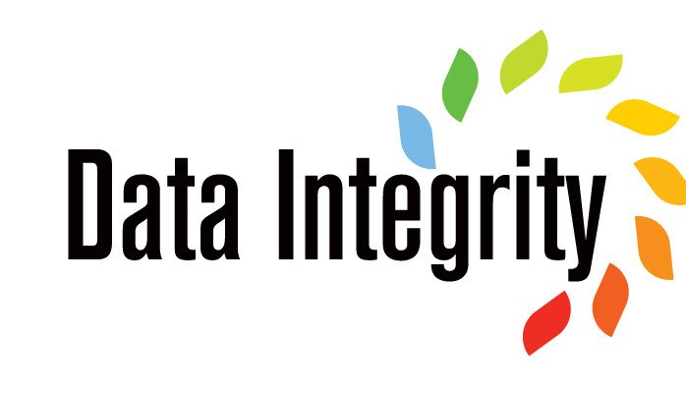
Integrity
Internal consistency, validity, fitness for use
Avoiding physical corruption
E.g., medical record trashed or data garbled
Avoiding logical corruption
E.g., inconsistencies between nurses’ info and doctors’ info about case

Slide 9
Authenticity
Correspondence to intended meaning
Avoiding nonsense
E.g., mislabeling patient’s weight as patient’s age
Avoiding fraud
E.g., recording wrong doctor’s name in patient record to defraud Medicare w/ higher fees

Slide 10
Availability
Timely access to data
Contextual
No absolutes
Depends on needs & expectations
Delays can cause problems
Medical informatics – danger to patient
Sensors on insulin pumps failing to respond quickly
Ordering supplies – run out of essentials

Slide 11
Utility
Usefulness for specific purposes
Avoid conversion to less useful form
E.g., replacing milliliters by ounces
Using inconsistent metrics (e.g., ounces sometimes but grams elsewhere – without documentation)
Printing information in wrong font; e.g., Cyrillic instead of Roman
Impenetrable transforms
E.g., employee encrypts source code and loses decryption key
Data still there but not USEFUL

Slide 12
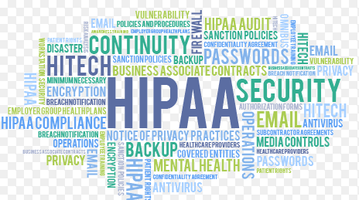
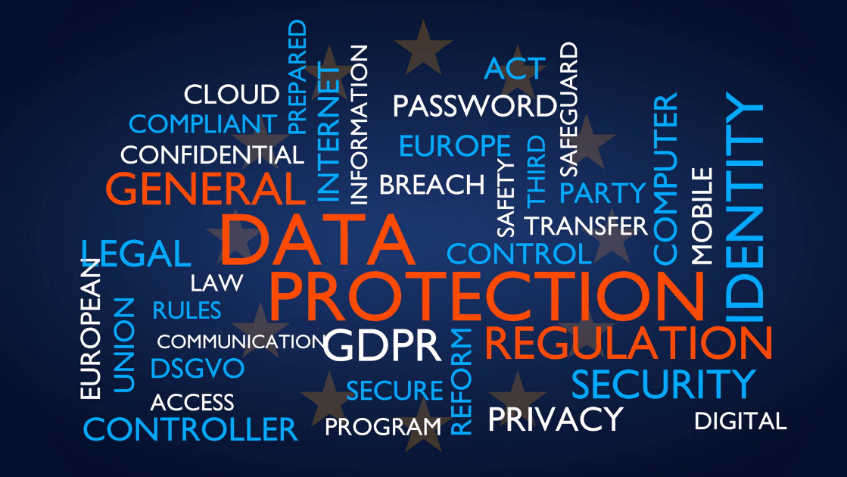
Why Protect Confidentiality of Medical Information?
Confidentiality a standard
Supports patients’ trust in medical establishment
Legal requirements (e.g., HIPAA/USA, GDPR/EU)
Security requirements are contextual
Medical information may have differing degrees of sensitivity depending on problem (e.g., STDs)
May depend on
Personality of patient
Family dynamics
Social circles
Community values

Slide 13
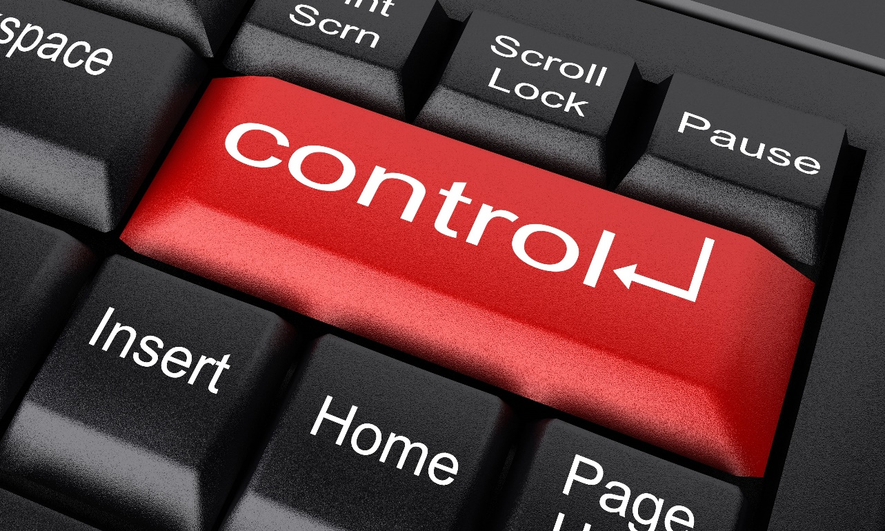
Control of Medical Data
Essential that only authorized personnel have access
For recording data
For reading data
For changing data
Reading / Modifying / Mislabeling / Delaying or Denying Access to medical info pose extreme dangers
To patients
To staff
To organization

Slide 14
Integrity of Medical Data
Medical decisions depend on accurate, timely information
Cannot afford to scramble values affecting patient care
Hackers have penetrated hospital systems
Changed settings on medical equipment
Serious risks from Internet-connected equipment (IoT – Internet of Things)
Frequently inadequately secured
Some equipment has same ID & password for all units out of the box (“canonical passwords”)

Slide 15
Authenticity Issues in Medical Records
Having wrong name of provider may cause serious problems
Unauthorized prescriptions or treatments
Inappropriate recommendations for care could result in
Criminal prosecutions
Civil lawsuits
Mislabeling information could be lethal
E.g., recording a blood-chemistry value as if it were information about pulmonary capacity

Slide 16
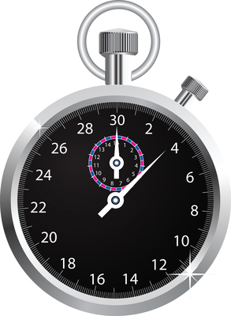
Availability is Critical
Timely access to patient info crucial
Delays could be lethal
Radiography results
Oncology lab reports
Management decisions affected by delays
Failure to receive timely info about staff performance
Epidemiology data must be dealt with quickly

Slide 17
Utility Matters
Human-interface design may discourage or encourage use of medical-records systems
Recent case
Doctors received new computer stations for recording info during patient exams
However, IT failed to take into account physical layout of exam rooms
Forced physicians to face wall to make notes – breaking eye contact with patient
Result: doctors refuse to use system

Slide 18
Classic Errors in Medical INFOSEC
Nursing station computer left logged on 24 hours/day to Nurse Winthrop’s ID – 43 days after login!
Impossible to tell which nurse did what
Receptionist calls out full name of patients in crowded waiting room
Doctors discuss named patients in elevators – with other community members present
Staff discard confidential patient paper records without shredding
Unsecured wireless networks
Medical records sent by unsecured email

Slide 19
Priorities for Medical Records
Strong identification & authentication of all personnel accessing medical data
Passwords are TERRIBLE
Use tokens such as radio-frequency badges for immediate access
Encryption of all stored info
Decryption keys stored separately
Multiple copies of keys
At least two authorized people required for access to keys

Slide 20
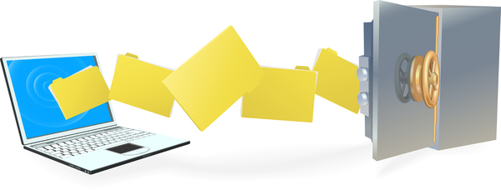
Backups & Incident Response
Information must be copied regularly
Frequency depends on lability & value
Stored on media NOT CONNECTED to system
Strong access controls for backups
Must not be susceptible to ransomware
Backups must be tested before being stored
Careful planning & practice for recovery
Analyze various scenarios
Identify appropriate responses & recovery plans
PRACTICE THEM
Analyze practice sessions for improvement

Slide 21
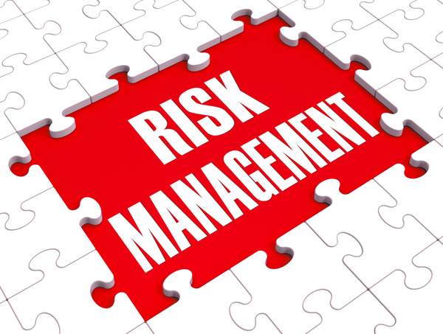
Risk Management Issues
Some managers discount security
It’ll never happen here
Who would want to harm us?
It’s never happened yet
It costs too much
Security failures can kill people
Violations of law may shut down facilities
HIPAA (US Health Insurance Portability and Accountability ACT)
GDPR (EU General Data Protection Regulation)
Organizations may be bankrupted by liability payments to victims

Slide 22
SUMMARY
MEDICAL INFOSEC MATTERS!

Slide 23
DISCUSSION

