Slide 1
INFOWAR:
Introduction to Cyberwarfare
M. E. Kabay, PhD, CISSP-ISSMP
Professor of Computer Information Systems
School of Business & Management
College of Professional Schools
Norwich University
Notes:
M. E. Kabay, PhD, CISSP

Slide 2

Overview
Part 1: Introduction to Information Warfare
Part 2: Weapons
Part 3: Military
Perspectives
Part 4: Cyberdefense
Policy Issues
Part 5: Emerging
Vulnerabilities &
Threats

Slide 3
Part 1: Introduction to Information Warfare
Introduction
Vulnerabilities
Goals and Objectives
Sources of Threats and Attacks
Weapons of Cyberwar
NOTE:
References to “CSH6” are to this textbook:
Bosworth, S., M. E. Kabay, & E. Whyne (2014), eds. Computer Security Handbook, 6th Edition. Wiley (ISBN 978-0471716525). 2 volumes, 2240 pp. AMAZON < http://www.amazon.com/Computer-Security-Handbook-Seymour-Bosworth/dp/1118127064/ > or
< http://tinyurl.com/ldg9c8r >
See in particular Chapter 14: “Information Warfare” by S. Bosworth.

Slide 4
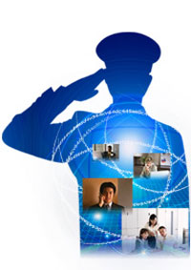
Introduction
Definition*
  Offensive and defensive use
  of information & information
  systems
  To deny, exploit, corrupt or
  destroy
  An adversary’s information,
  information-based processes,
  information systems, and
  computer-based networks
  While protecting one’s own.
  Designed to achieve
  advantages over military or business adversaries.
Used with permission of
Robert Duffy, Avalon5.com
_____________
*Dr Ivan Goldberg, Institute for Advanced Study of Information Warfare

Slide 5
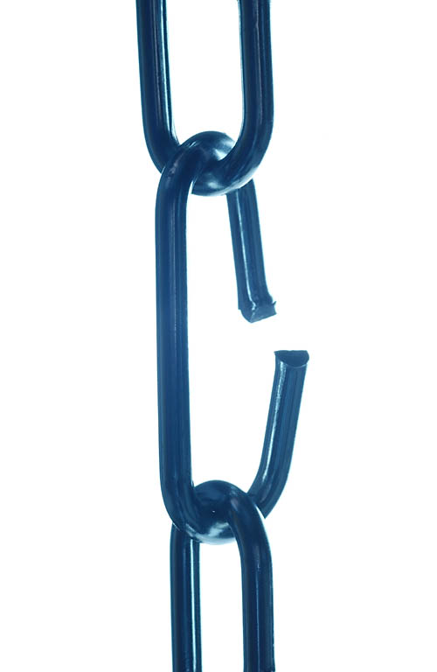
Vulnerabilities
Critical Infrastructure
COTS Software
Dissenting Views
Rebuttal

Slide 6

Critical Infrastructure
Presidential Decision Directive 63 (PDD-63)
  President Clinton (1998)
  http://www.fas.org/irp/offdocs/pdd-63.htm
  Defined US critical infrastructure includes
    Telecommunications
    Energy
    Banking and finance
    Transportation
    Water systems
    Emergency services
These systems are vulnerable to asymmetric warfare – effective attack by much weaker adversaries (e.g., Mafia Boy vs AMAZON & eBAY in 2000)

Slide 7
COTS Software
Military and civilian sectors both depend on COTS (commercial off-the-shelf ) software
  Microsoft OS has become
  monoculture
  Continues to be vulnerable to
  subversion
  Allows study and exploitation by
  adversaries
Some hardware being manufactured
in potentially hostile nations
  Much manufacturing in PRC
  Some claims of hardware Trojans (e.g., keyboard equipped with keylogger)

Slide 8
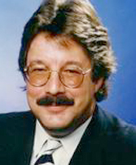
Dissenting Views
Some critics dismiss discussion of cyberwar as FUD
  Fear, Uncertainty and Doubt
  Designed to increase sales of hardware, software and consulting services
Personal attacks on early promulgators of information warfare doctrine
  Controversial figure: Winn Schwartau
  Author of novel Terminal Compromise
  Nonfiction Information Warfare and
  Cybershock texts
  Lampooned as wild-eyed
  self-publicist
  Actually a committed security expert

Slide 9
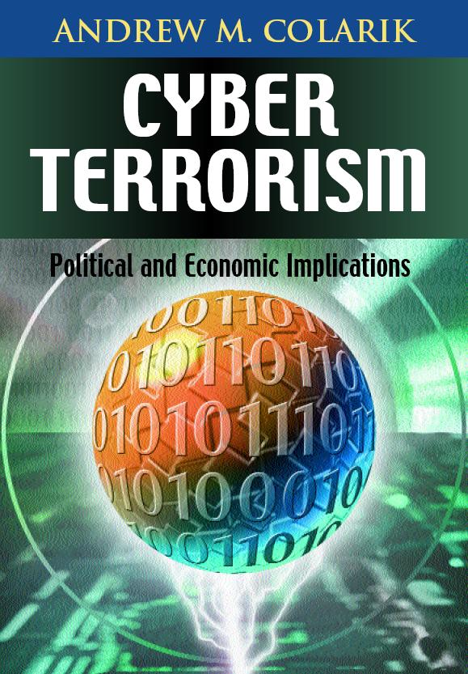
Rebuttal to FUD claims
Growing evidence of asymmetric use of information systems in conflicts
Industrial espionage from PRC
growing
Conflicts around world demonstrate role
of Internet as tool and target
  India/Pakistan
  Bosnia
  Koreas
  Iranian unrest in June 2009
  Arab Spring
  ISIS/ISIL/DAESH
Potential remains high – e.g., PSYOP using flash crowds to obstruct emergency personnel or create targets for terrorists

Slide 10
Goals and Objectives of IW
Military
Government
Transportation
Commerce
Financial Disruptions
Medical Security
Law Enforcement
International &
Corporate Espionage
Communications
Economic Infrastructure

Slide 11

Military Perspective
US Joint Doctrine for Operations Security (OPSEC)
  Identifying critical information
  Analyzing friendly actions in military ops
  Identify which ops can be
  observed by adversaries
  Determine what adversaries
  could learn
  Select and apply measures
  to control vulnerabilities to
  minimize adversarial
  exploitation
Some discussion of potential offensive cyberoperations
  US Air Force established AF Cyber Operations Command to be stood up June 2009
  US Army established 2009 Army Posture Statement on Cyber Operations

Slide 12
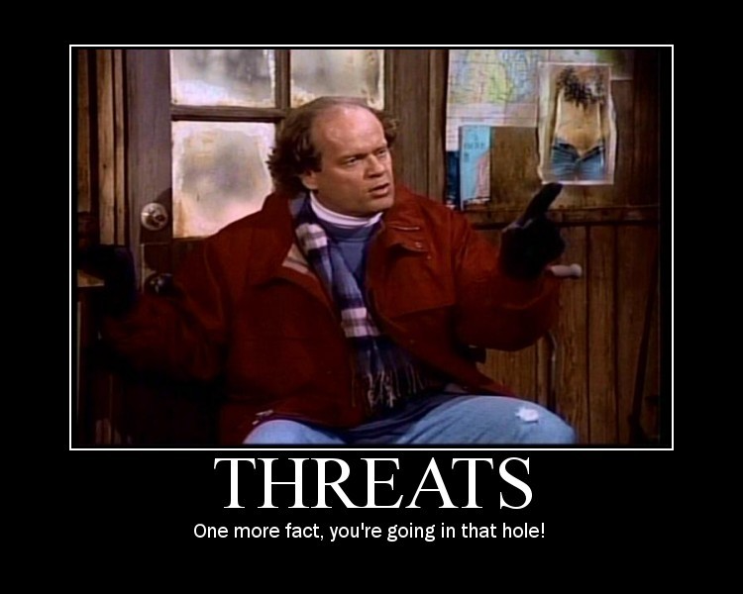
Sources of IW Threats and Attacks
Nation-States
Cyberterrorists
Corporations
Activists
Criminals
Hobbyists
Image © 2009 Beatrix Kiddoe. Used under terms of service of Photobucket.
http://media.photobucket.com/image/threats/BeatrixKiddoe/motivator639310.jpg?o=19

Slide 13

Nation-States: China
People’s Republic of China major actor
  People’s Liberation Army doctrine explicitly includes information warfare
  Widespread evidence of
  massive probes and attacks
  originating from China
  through state sponsorship
  Formal training for cadres
Other countries involved in information warfare
  ECHELON (SIGINT) organized by UK-USA Security Agreement (Australia, Canada, New Zealand, the United Kingdom, and the United States)

Slide 14
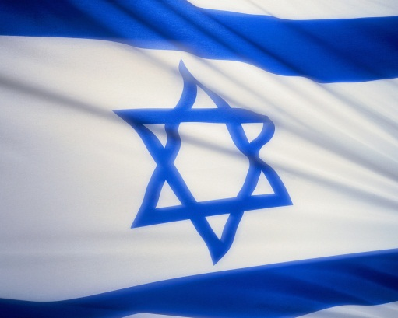
Nation-States: Stuxnet (2010)
Written to subvert SCADA for
Siemens centrifuge programmable
logic controllers (PLCs)
  Damaged Uranium-enrichment
  centrifuges in Iran
  Spun too fast – crashed physically
60% of Stuxnet infections were in Iran
Speculations that US & Israel
wrote Stuxnet Worm
  No direct proof
  Circumstantial evidence includes codes and dates that might be related to Israel
  Documents supporting view that US involved were released by Edward Snowden in July 2013

Slide 15

Cyberterrorists
Remains a theoretical possibility
Individual criminal-hacker /
hobbyist attacks raise concerns
  Documented interference
  (mostly pranks) with
    Ground traffic
    Emergency 911 systems
    Air-traffic control
    Hospital systems….
Pranksters have been spreading
false news via Twitter (deaths of
celebrities….)
Growing use of insecure wireless
systems raises additional concerns for PSYOP

Slide 16



Corporations (1)
Potential for sabotage against rivals
  Documented cases of interference using computers and networks
1999 – BUY.COM underpriced its $588
Hitachi monitors at $164 – perhaps
through effects of competing knowbots
2000 – Sun accused Microsoft of corrupting Java
to interfere with platform independence
2000 – Steptoe & Johnson employee accused of denial-of-service attack on Moore Publishing
2000 – AOL accused of interfering with other
ISPs by tampering with Internet settings

Slide 17
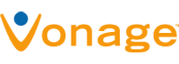
Corporations (2)
2005 – FCC investigated phone
company ISP interference with Vonage VoIP
2006 – Businessman selling t-shirts hired hacker to damage competitors using DDoS
  Infected 2000 PCs with slave programs in botnet
  Disabled Websites and online sales
  Jason Arabo (19 years old) sentenced to 30 months prison & $500K
  restitution
  Younger hacker (16 years
  old) sentenced to 5 years
  prison & $35K restitution

Slide 18
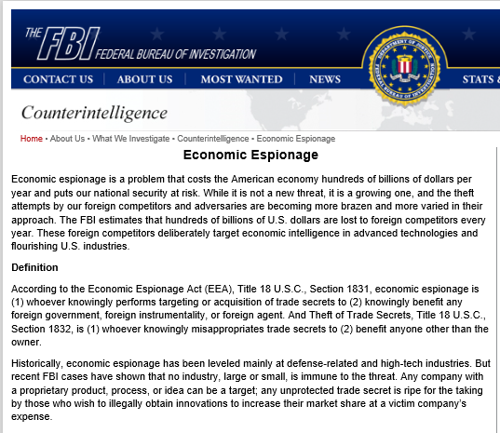
Corporations (3)
FBI deems economic espionage serious problem: < https://www.fbi.gov/about-us/investigate/counterintelligence/economic-espionage >

Slide 19
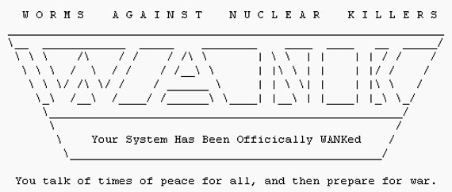
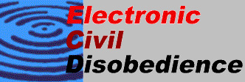
Hacktivists (1)
Hacktivists use criminal hacking in support of politics or ideology
1989: WANK (Worms
Against Nuclear
Killers)
  Infected DOE,
  HEPNET & NASA
  networks
  “You talk of times of peace for all, and then prepare for war.”
1998: Electronic Disturbance Theater
  Indigenous peoples’ rights in Chiapas, Mexico

Slide 20

Hacktivists (2)
1998: Free East Timor (Indonesian Web sites)
1998: Legions of the Underground declared cyberwar on Iraq and China
1999: Jam Echelon Day: traffic with many keywords thought to spark capture by spy network
2000: World Trade Organization
  Hackers probed Web sites
  700 times
  Tried to penetrate barriers
  54 times
  Electrohippies launched
  DoS attack

Slide 21


Hacktivists (3)
2004: Electronic Disturbance Theater launched DoS on conservative Web sites during Republican National Convention
2008: Project Chanology launched against Church of Scientology
2008: Chinese hackers attacked CNN Web sites to protest Western media bias
2009: much Web-defacement activity during attack by Israel on Gaza

Slide 22
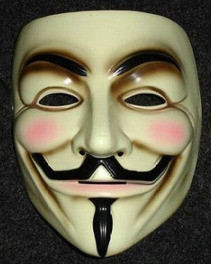
Hacktivists (4)
Anonymous (Anon)
  2003 – 4chan board
  No leaders
  Focus on defending Wikileaks in 2010-2011
  Attacked Church of Scientology
  QUESTION: doing good or not?
  See extensive list at
  < https://en.wikipedia.org/wiki/Timeline_of_events_associated_with_Anonymous >
Guy Fawkes Mask

Slide 23
Hacktivists (5):
Recent Campaigns by Anonymous
2014
  Ferguson re shooting of Mike Brown
  Operation Hong Kong vs government repression
  Attacks on Philippine govt for poor response to Super Typhoon Yolanda
2015
  Charlie Hebdo – condolences, target Jihadists
  Islamic State – thousands of ISIS Websites, Twitter accounts inactivated
  Death Eaters – pedophiles attacked
  Stop Reclamation – 132 PRC govt Websites attacked
  StormFront – neo-Nazi group attacked
  OPKKK – revealing names of KKK members

Slide 24
Criminals (1)
Stock manipulation: pump ‘n’ dump schemes
  NEI Webworld pump-and-dump (Nov 1999)
  2 UCLA grad students & associate bought almost all shares of bankrupt NEI Webworld company
  Using many different pseudonyms, posted >500 messages praising company
  Also pretended to be company interested in acquisition
  Within 1 day stock value increased from $0.13 to $15 per share
  Made ~$364K profit

Slide 25
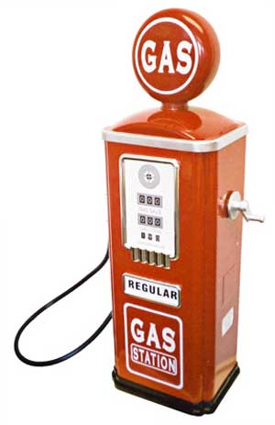
Criminals (2)
Los Angeles gasoline-pump fraud (1998)
  New computer chips in gasoline pumps
    Cheated consumers
    Overstated amounts 7%-25%
  Complaints about buying more
  gasoline than capacity of fuel tank
    Difficult to prove initially
    Programmed chips to spot 5 & 10
    gallon tests by inspectors
    Delivered exactly right amount for
    them!
Organized crime (esp. Russian, Eastern
European) involved in identity theft
Methods and targets could be used in organized state-sponsored information warfare, especially if SCADA (supervisory control and data acquisition) systems targeted

Slide 26
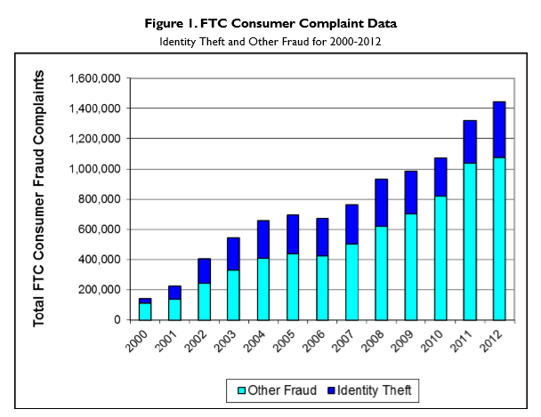
Criminals (3) – Identity Theft
Figures from Finklea, K. (2014). “Identity Theft: Trends and Issues.” Congressional Research Service. Report #7-5700. 27 pp. P. 11.
< https://www.fas.org/sgp/crs/misc/R40599.pdf >

Slide 27
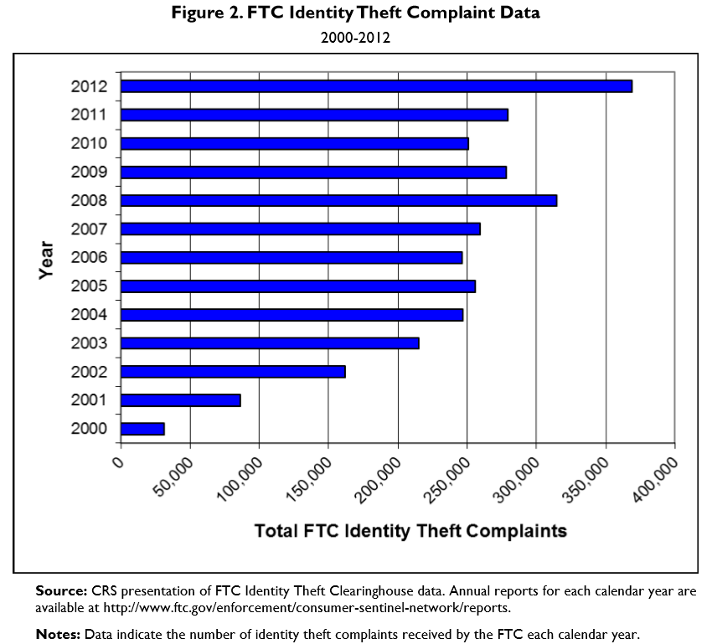
Criminals (4) – ID Theft cont’d

Slide 28
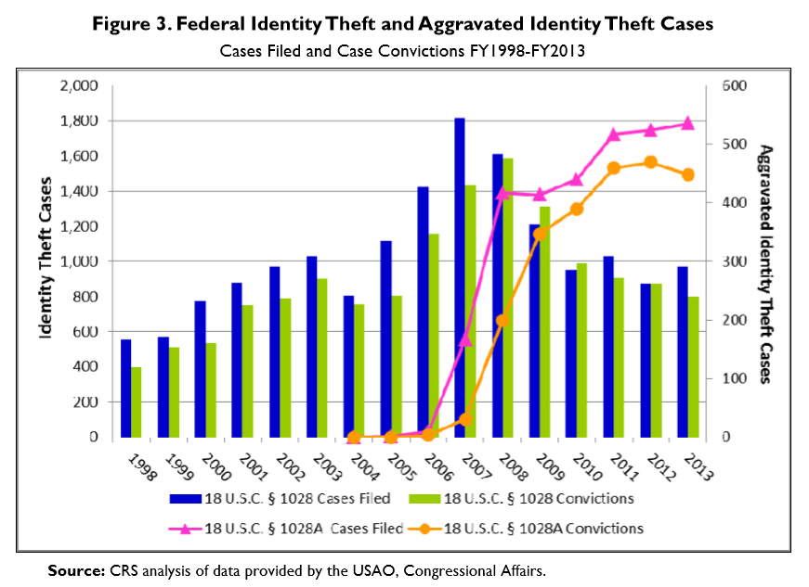
Criminals (5) – ID Theft cont’d

Slide 29
Criminals (6) – Ransomware
1989 – AIDS Information Diskette
  Scrambled names of folders & files
  Demanded payment to unlock
Today: ransomware
  Encrypts data
  Demands payments using Bitcoin
  Extortion of $10K-$100K

Slide 30
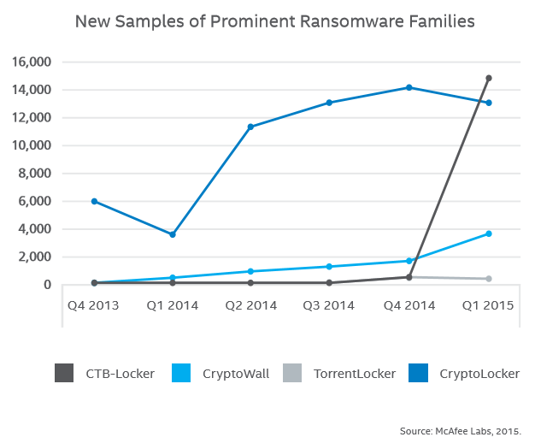
Criminals (7) – Ransomware cont’d
From McAfee Labs Threats Report (May 2015).
http://www.mcafee.com/us/resources/reports/rp-quarterly-threat-q1-2015.pdf

Slide 31
Part 2:
Weapons

Slide 32
Part 2: Weapons of Cyberwar
Denial of Service
Malicious Code
Cryptography
PSYOP
Physical Attacks
Biological & Chemical WMD
Weapons Inadvertently Provided

Slide 33
Examples of INFOWAR Techniques
This next section is designed to impress newcomers to the INFOWAR field with the existing variety and complexity of cyberthreats.

Slide 34

DoS Overview (1)
Denial-of-service attacks (DoS) & DDoS (Distributed DoS) attacks
  Render target systems / networks unusable or inaccessible
  Saturate resources or cause catastrophic errors
  Difficult to prevent without widespread cooperation among ISPs
DoS & DDoS attacks powerful tool for asymmetric warfare
  Attacker resources can be modest
  Consequences can be severe

Slide 35
DoS Overview (2)
Can also occur by mistakes causing
positive feedback loops e.g.,
Autoforwarding between 2 e-mail
accounts
  When target fills up, sends bounce
  to original address which forwards
  bounce to full account which generates
  new bounce which… until mailbox fills up
Out-of-office replies to lists
  Message sent to everyone on list
  Including absent person…
  …whose e-mail sends out-of-office reply to entire list including same absent person….
Competing Web-bots
  E.g., automatically reducing price below each other’s sale price….

Slide 36

History of DoS (1)
Early systems subject to resource exhaustion
  HP3000 console (early 1980s) received all system messages
    Logons, logoffs, requests for paper & tape
  Pressing any key on console without pressing  key blocked incoming system messages
  System buffers filled up with messages
  No further actions requiring notifications
    No one could finish logging on or off
    Anyone asking for tape/paper froze
All systems that use obligatory user lockout at risk of DoS
  Attacker need only log on to all userIDs with bogus password – locks everyone out

Slide 37

History of DoS (2)
1987-12: Christmas-Tree Worm
  IBM internal networks
  Grew explosively
  Self-mailing graphic
  Escaped into BITNET
  Crashed systems
1988-11: Morris Worm
  Probably launched by mistake
  Demonstration program
  Replicated through Internet
  ~9,000 systems crashed or were deliberately taken off-line
  Was about ½ to ¾ of Internet as it was then

Slide 38

History of DoS (3)
Panix Attacks of September 1996
Unknown criminal hacker attacked the PANIX Internet Service Provider
"SYN-flooding attack"
  Stream of fraudulent TCP/IP requests for connections
  Non-existent Internet addresses
  Overwhelmed server
  Denied service to legitimate users
TCP/IP specialists immediately developed patches to prevent recurrence

Slide 39
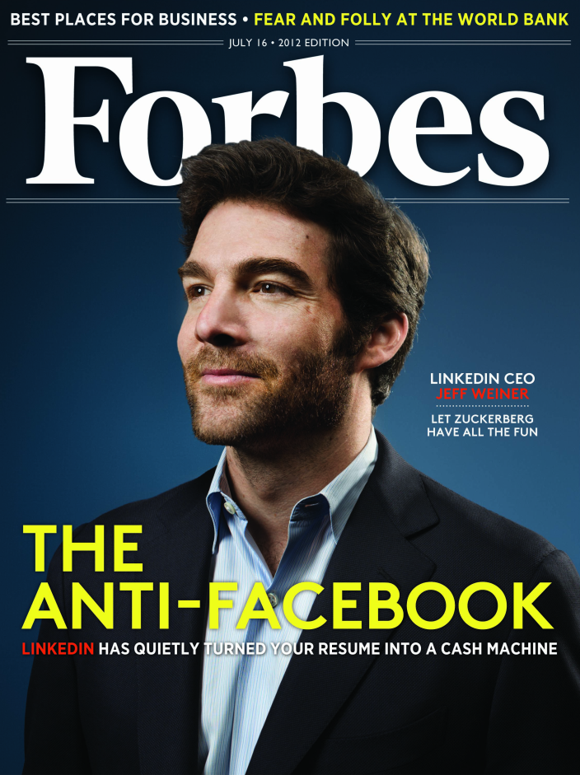
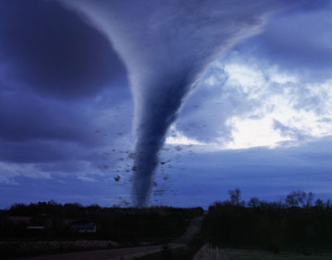
History of DoS (4)
Forbes (Feb 1997)
  Disgruntled employee George Parente
  deleted budgets, salary data
  Crashed 5 of 8 network servers
  Systems down 2 days – costs >$100K
  Arrested by FBI – pled guilty
Windows NT servers attacked (Mar 1998)
  Repeated crashes
  Included NASA, .mil, UCAL sites
Australian mailstorm (May 1998)
  Bureaucrat set autoreply +
  autoconfirmation to be sent to 2,000
  users in network
  Generated 150,000 messages in
  4 hours
  His own mailbox had 48,000 e-mails
  + 1,500/day arriving

Slide 40

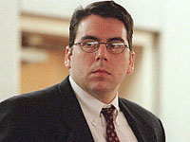
History of DoS (5)
Melissa Virus (Mar 1999)
CERT-CC reported fast-spreading new MS-Word macro virus
  Melissa written by “Kwyjibo/VicodenES/ALT-F11”
  to infect Word documents
  Uses victim's MAPI-standard e-mail address book
  Sent copies of itself to 50 most e-mailed people
  E-mail message w/ subject line
  "Important Message From <name>”
Spread by David L. Smith (Aberdeen, NJ)
  Spread faster than any previous virus
  Took down ~100,000 e-mail servers
  Estimated $80M damages
  Convicted in 2002 of knowingly spreading computer virus
  Sentenced to 20 months in federal prison + 100 hrs community service

Slide 41
Costs of DoS
Direct costs often difficult to compute
Indirect costs involve
  Loss of immediate business
    Consumers switch to another Website if a vendor’s system is too slow
  Loss of customer confidence
    Many customers stay with latest supplier
  Potential legal liability under SLAs (Service Level Agreements)
  Costs of recovery
  National security issues
$$$

Slide 42
Damages from DoS and DDoS: Tort
Potential tort liability from allowing system to be used for harmful activities
  Possible that victims of DoS and DDoS will sue intermediate hosts for contributory negligence
Existing law in USA establishes requirements for best practices in preventing harm
  Industry standards are common basis
  Competitive pressures may move corporations to prevent misuse of their systems by DoS and DDoS tools
Notes:
Radin, M. J. (2001). Potential tort liability for damages due to DDoS attacks. Part II of “Distributed Denial of Service Attacks: Who Pays?” http://www.mazunetworks.com/radin-2.html

Slide 43
Specific DoS Attacks
Destructive Devices (Malicious software)
  Logic bombs
  Viruses, worms, Trojans
  Exploits of known vulnerabilities
E-mail Bombing & E-mail Subscription-list Bombing
Buffer Overflows
Bandwidth Consumption
Routing & DNS Attacks
SYN Flooding
Resource Starvation
Java
Router Attacks
Other Resources
See CSH6 Chapter 16,
Malicious Code

Slide 44
E-mail-Bombing (1)
In early days of e-mail (1980s), anyone could flood mailboxes
  ISPs imposed strict limits on number of outbound e-mails
  EULAs / Terms of Service explicitly
  forbid flooding
  But could still use e-mail lists to flood
  victims
1996-08 — “Johnny [x]chaotic”
  Subscribed dozens of people to hundreds
  of lists
  Victims received up to 20,000 e-mail
  msg/day
  Published rambling, incoherent manifesto
  Became known as “UNAMAILER”
  Struck again in December
Caused serious re-evaluation of e-mail list management

Slide 45

E-mail Bombing (2)
Root problem
  Some list managers automatically subscribed people without verification
  But now almost all lists verify authenticity of request
  Send request for confirmation to supposed recipient
But can still flood victim using automated
subscription requests
  Thus many list managers
  now use CAPTCHAs*
*Completely Automated Public Turing
test to tell Computers and Humans Apart

Slide 46
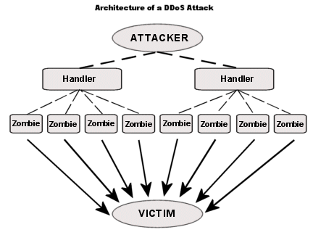
Overview of DDoS (1)
http://tinyurl.com/hl3m7kj

Slide 47
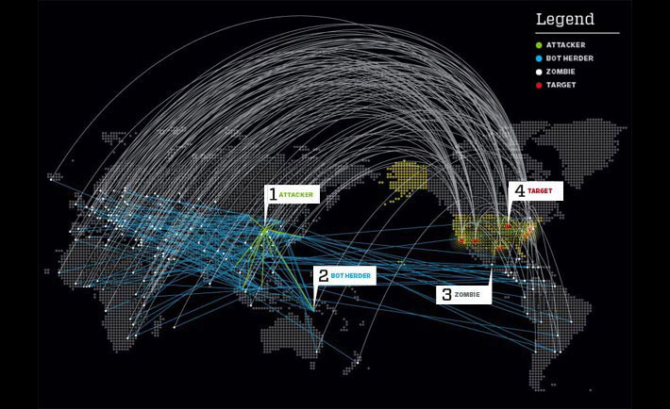
Overview of DDoS (2)
Attacker subverts poorly secured system
Controls tools to send large volumes of coordinated traffic against target
Massive multiplier effect
Packets arrive from many different sources
  Makes packet filtering by source impossible
Sources can be
manipulated for
PSYOP in
information
warfare –
misleading
impressions

Slide 48

History of DDoS (1)
Jun & Jul 1999: Trin00
(aka Trinoo)
  Thought to be 1st DDoS tool
  Tested on 2,000 systems
  worldwide
Aug 1999: large-scale deployment of Trin00
  >227 systems used as sources
  Attacked 1 University of Minnesota computer – down 2 days
Dec 1999: CERT/CC® issued CA-1999-17 discussing DDoS for 1st time
Feb 2000: Mafiaboy attacks multiple e-commerce sites (see next slide)

Slide 49
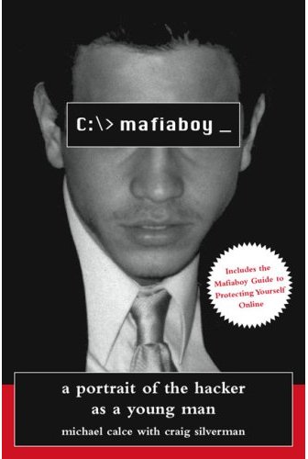
History of DDoS (2)
February 7, 2000 attack from “Mafiaboy”
  Michael Calce, 15 year-old boy from Montréal area, Canada
  Used a dial-up modem to control DDoS
Effects
  Yahoo.com inaccessible 3 hours
  Est. $500,000 loss in revenue
  Stock value fell 15%
Feb 8:
  Amazon.com 10 hours – $600,000 loss
  Buy.com – 9.4% availability stock lost
  44% of value
  CNN – user count fell to 5% of normal
  eBay stock value fell 24%
Feb 9:
  E*Trade & ZDNet – completely unreachable
  Charles Schwab – brokerage down – no exact figures
Notes:
Mazu Networks (2000). White Paper: The Denial of Serfice Problem. http://www.mazunetworks.com/wp_ddos.html
Radin, M. J. (2001). Distributed Denial of Service Attacks: Who Pays? http://www.mazunetworks.com/radin-toc.html
Costello, S. (2001). NIPC warns against increased DDoS attacks. http://www.nwfusion.com/news/2001/1105nipc.html

Slide 50

History of DDoS (3)
May 2001: Attacks on
Steve Gibson’s GRC.com
  Well-known security
  expert, writer, programmer
  13-year-old attacker used
  IRC bot
Oct 2002: DNS servers
attacked
  All 13 top-level Domain
  Name System root servers
  swamped by DDoS for 2 hours
  9 servers went down – only 4 continued working
  A few more hours might have knocked all the root servers off the ‘Net – could have stopped entire Worldwide Web

Slide 51

History of DDoS (4)
DDoS as tool for extortion
  Growing number of criminals (and criminal organizations) threaten DDoS attacks unless paid ransom
  Demonstrate power by interrupting service
  Most victims stay quiet about extortion
Jan 2009: TechWatch digital TV site down
  DDoS allegedly using 9,000 bots
  for SYN flood
  446Mbps avalanche of packets
  rose to 2 Gbps
  Victim applied advanced traffic filters
  Attackers demanded ransom
Notes:
Pappalardo, Denise and Ellen Messmer (1995). Extortion via DDoS on the rise: Criminals are using the attacks to extort money from victimized companies. Computerworld (May 16, 2005). < http://www.computerworld.com/s/article/101761/Extortion_via_DDoS_on_the_rise >
Leyden, J. (2009). Techwatch weathers DDoS extortion attack: Botnet blackmail. The Register (Jan 30, 2009). < http://www.theregister.co.uk/2009/01/30/techwatch_ddos/ >

Slide 52

DDoS Attack on Social Networking Sites – Aug 2009
Aug 6-8, 2009 – SNS under attack
  Twitter down
  LiveJournal down and up
  Facebook slow
  Gawker affected
  Xbox Live
  Some Google services
Analysts believe attack was aimed at 1 blogger
  Cyxymu outspoken critic of South Ossetia war
  Writes in “Georgianised Russian”
  DDoS attack blamed on Russian hackers*
*Example of
hacktivism
Notes:
Rosenberg, D. (2009). Denial-of-service got Twitter. Is your network next? Cnet News (Aug 6, 2009). < http://news.cnet.com/8301-13846_3-10305241-62.html >
Anderson, K. (2009). Twitter and Facebook attacks: why your computer might have been involved. Guardian Technology Blog (Aug 7, 2009). < http://www.guardian.co.uk/technology/blog/2009/aug/07/facebook-twitter >
Mah, P. (2009). Twitter DDoS a somber reminder about the malice of botnets. FierceCIO TechWatch (Aug 7, 2009). < http://www.fiercecio.com/techwatch/story/twitter-ddos-somber-reminder-about-malice-botnets/2009-08-07 >

Slide 53
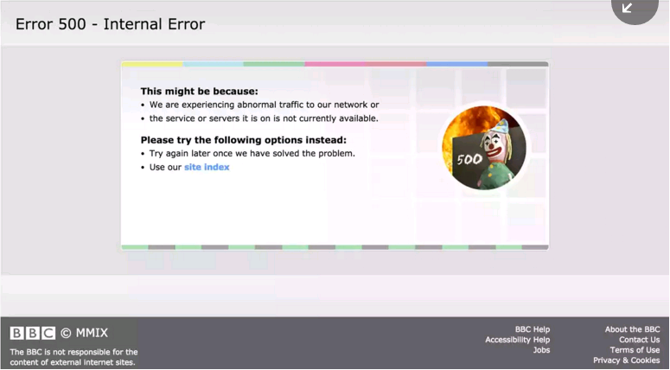
DDoS vs BBC TV Website
2016-01-02
BBC Website down
for few hours
DDoS
Post screenshot
w/ #tangodown
or #takendown
Anti-ISIS hackers
  New Word Hacking
  Claim pen-testing to fight ISIS
  “Only a test”

Slide 54

DDoS vs Irish Lottery
1121 GMT 2016-01-20 to 1325
Largest jackpot in 18 months
Could not buy tickets
  Machines blocked
  Website unresponsive

Slide 55
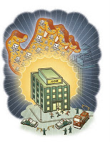
DDoS Terminology & Overview
Terms (synonyms)
  Intruder (attacker, client)
  Master (handler)
  Daemon (agent, beast,
  bcast program, zombie)
  Victim (target)
Process
  Intruder compromises insecure systems
  Installs master program
  Scans for thousands of weak systems
  Installs daemon code to listen for instructions
  Instructs owned systems to launch DDoS
Permission requested from Frans Charming
for permanent use of image

Slide 56
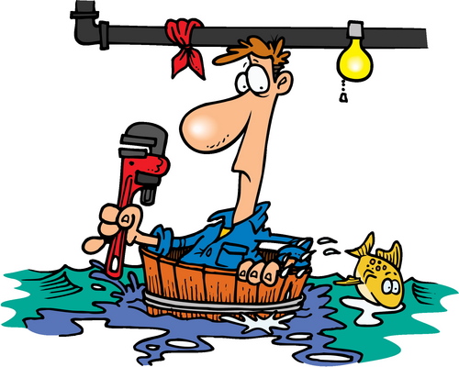
DDoS Tools – Details Elsewhere
Trin00
Tribe Flood Network
Stacheldraht
TFN2K
Trinity
Code Red Worm
NIMDA
Hidden Links in
Web Pages or
Programs

Slide 57
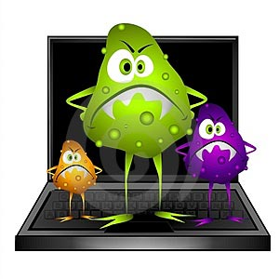
Malicious Code/Malware
Terminology:
  Viruses, worms, Trojan horses
    See CSH6 Chapter 16
  Mobile code such as Java, ActiveX,
  VBscript
    See CSH6 Chapter 17
Malware widespread
  In 1980s & 1990s used by individuals
  In 1990s & 2000s increasingly used by organized crime
  Significant evidence of state-run malware research and development

Slide 58

Linux.Ekcocms.1 Trojan
2016-01-16
Linux systems
Snaps screenshot
every 30 seconds
  INTEL: user activity
  Websites visited
  Programs used
Saves to folders on disk
  Uploads encrypted
  contents to remote server

Slide 59
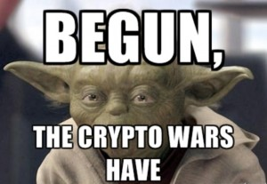

Cryptography Wars (1)
Cryptography used in military
operations for millennia
Cracking ciphertext top priority
for governments and criminals
  Parallel processing
  Ultra-high-speed computers
  (teraflops)
Debate about international traffic in strong cryptography
  International Traffic in Arms Regulation (ITAR) of US restricted export
  ITAR under control of State Dept
  Critics regarded ITAR application to
  cryptography as pointless

Slide 60

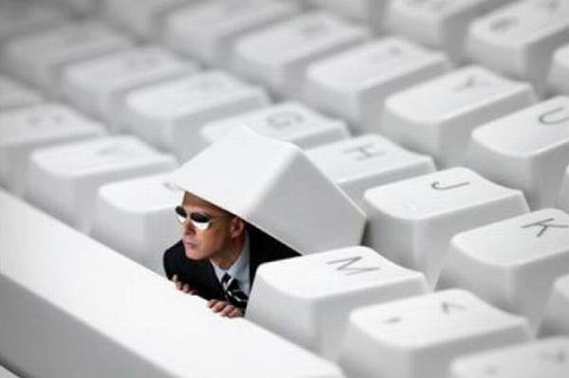
Cryptography Wars (2)
Control shifted to Export Administration Regulations (EAR)
  Dept of Commerce
  More liberal
Back doors to crypto
  Many governments/regimes demand access to encryption keys or “master keys”
  Civil-liberties groups
  oppose demand
    Weaken crypto for all
    users
    Usable by dictatorial
    regimes & criminals

Slide 61

PSYOP (1)
Psychological operations = PSYOP
  Planned psychological activities
  Directed to enemy, friendly, neutral
  audiences
  To influence emotions, motives,
  attitudes, objective reasoning &
  behaviors
  In ways favorable to originator
Targets at all levels (individuals, groups, organizations, military, civilian)
Goals
  Reduce morale & combat efficiency among enemy
  Promote dissension & defection among enemy
  Support deception operations by friendlies
  Promote cooperation, unit, morale in friendlies

Slide 62
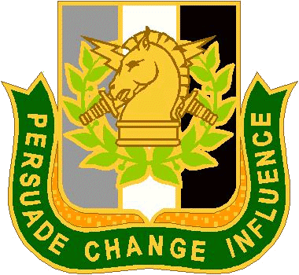
PSYOP (2)
Classic example of PSYOP: preparation for Normandy invasion (DISINFO)
  Allies fabricated & planted leaks
  about supposed invasion at
  Pas de Calais
  Nazis believed that General
  George S. Patton leading
  invasion
  Concentrated Nazi troops away
  from actual Normandy landing
  areas
Sep 11, 2001 WTC bombing & subsequent anthrax-spore scare illustrate effects similar to PSYOP – demoralization, economic consequences, changes in culture

Slide 63

Physical Attacks
Sep 11, 2001 attacks had noticeable effects on information infrastructure
Backhoe attacks facilitated
by warning signs about
where not to dig – indicate
communications trunks
Undersea cables susceptible
to sabotage
International prevalence of car bombings, suicide bombings & IEDs (improvised explosive devices) causing rethinking about weapons of cyberwar
Increased attempts to secure civilian infrastructure
But much of public policy described as security theater (after Bruce Schneier) by critics

Slide 64
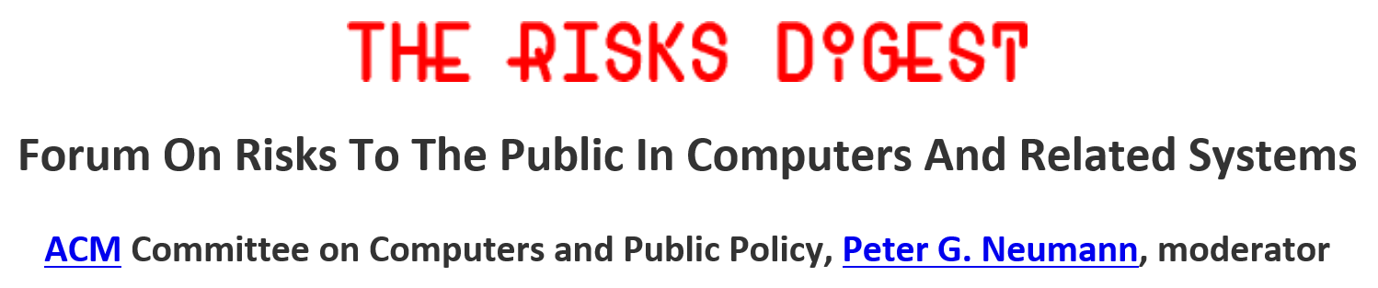
Weapons Inadvertently Provided
Vulnerabilities in software systems open nation to cyberwar
  Bad software design (see RISKS FORUM DIGEST)
  Poor software quality assurance
  Rush to market of incompletely tested software
See CSH6 Chapters
  38 Writing Secure Code
  39 Software Development & Quality Assurance
  40 Managing Software Patches & Vulnerabilities
https://catless.ncl.ac.uk/Risks/

Slide 65
Part 3:
Military Perspectives

Slide 66
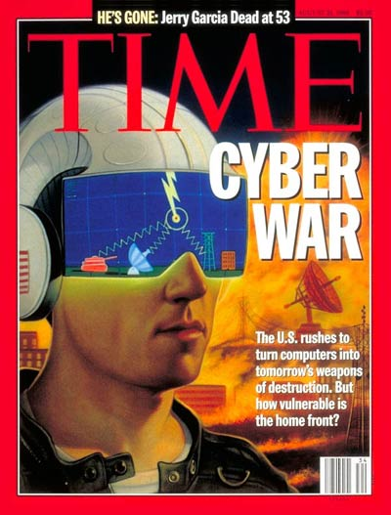
Part 3: Military Perspectives on Cyberwarfare
Fundamental problems
Asymmetric warfare: central concept
In-kind counterattacks
Forceful defenses
Industrial espionage
Critical infrastructure
Current battle with Daesh/ISIL/ISIS

Slide 67
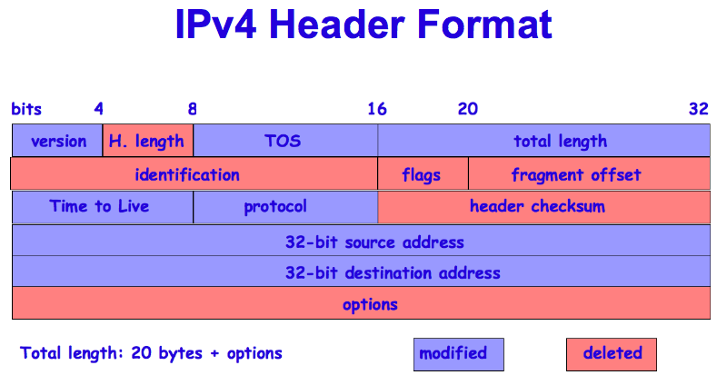
Fundamental Problems (1)
A fundamental flaw in today’s Internet:
  THERE IS NO GUARANTEE OF AUTHENTICITY IN IPV4
  Origination IP addresses can be spoofed!
  A 12 year old hacker can make packets coming from her computer look like they come from Albania
  IPv6 does
  include strong
  authentication
    But it isn’t
    yet widely
    implemented

Slide 68
Fundamental Problems (2)
Criminals & hostile forces can use distributed attacks
  Botnets created by commandeering poorly-secured computers owned by amateurs
  Botnets can have 10,000 zombies
Distributed networks are impervious to take-down
  Multiple connectivity
  Multiple replication
  Shut down one TOR node, no one notices*
See e.g., Dingledine, R., N. Mathewson, & P. Syverson (2006).
“Tor: The Second-Generation Onion Router.”
< http://hatswitch.org/~nikita/courses/ece598nb-sp06/slides/tor.ppt >

Slide 69

Asymmetric Warfare
Defense more expensive than attack
Probability of at least 1 weakness
  Increases as number of potential attack points grows
P(system breach) = 1 – (1 - p)^{n} where
  p = probability of unit failure &
  n = number of independent possible breach points or
P = 1 – Π(1 - p_{i}) where
  Π is multiplication
  p_{i} = probability of failure of unit i

Slide 70
In-Kind Counterattacks
Problematic because of address spoofing
  Not certain where attacks originate
  Could attack wrong target
Recent incidents have been inconclusive
  Israelis vs Arabs
  Taiwan vs PRC
  Kashmir vs India
  Serbs vs Albanians
  PRC vs USA
Fundamental asymmetry of attacker/defender makes counterattacks in kind futile

Slide 71
Forceful Defenses Unlikely
Barriers to the use of force
  US increasingly reluctant to use force without international support
  Identity of attackers may be unclear
  Spoofing may lead to misidentification
  Difficult to characterize specific incident as cyberattack, error, accident, or malfunction
  Attackers may not be state actors – cannot launch war against criminals, activists, individuals
  UN doctrine limits reactions to proportional response
Thus unlikely to see forceful response to cyberattack

Slide 72
Industrial Espionage
Stahl, J. (2016-01-17). “The Great Brain Robbery: Economic espionage sponsored by the Chinese government is costing U.S. corporations hundreds of billions of dollars and more than two million jobs.” Sixty Minutes, CBS News.
< http://tinyurl.com/hae3fne3 >
US Dept of Justice describes Chinese cyberespionage as “national security emergency”
Government-sponsored hackers attack 1000s of US private corporations
US companies doing business in PRC have trade secrets consistently stolen

Slide 73
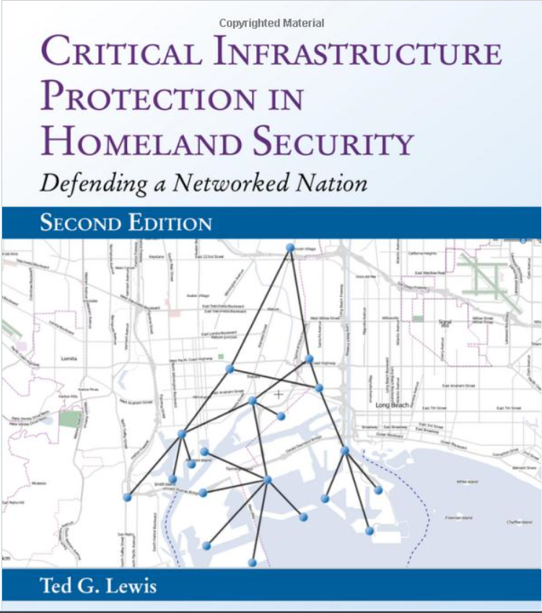
Critical Infrastructure
http://smile.amazon.com/gp/product/111881763
Electricity generation,
production & distribution (PTD)
Gas PTD
Oil and oil products PTD
Heating systems
Financial services (banking, clearing)
Security services (police, military)
Water supply (drinking water, waste
water/sewage, flood control)
Telecommunication (radio, TV, phones,
Internet)
Public health (hospitals, clinics,
medicines, ambulances)
Agriculture, food PTD (supplies, storage, wholesale, retail)
Transportation systems (fuel supply, railway network, airports, harbors, trucking for inland shipping)

Slide 74
Critical Infrastructure Attacked
Volz, D. (2016-02-25). “U.S. government concludes cyber attack caused Ukraine power outage.” Reuters < http://tinyurl.com/hsf47hl >
2015-12-23
  225,000 people affected
  1st known successful cyberattack on a grid
  Likely from Russian Sandworm group
Installed malware that switched breakers off
DoS on customer-service phones
  Prevented real customers from reporting outages

Slide 75
DAESH/ISI & Social Media
PSYOP a critical element of strategy
  Attracting recruits
  Using YouTube, Twitter, Facebook….
  Gruesome videos of violence appeal to angry young people
  Shifting to also including “normal” “fun” info about members
More info:
  Wagner, D. (2015). “What the Islamic State Is Teaching the West About Social Media.” TheWorldPost.
  < http://tinyurl.com/jz8pfae >
  Wallin, M. (2015). “Winning the Social Media War Against ISIS.” American Security Project.
  < http://tinyurl.com/j8l9mak >

Slide 76
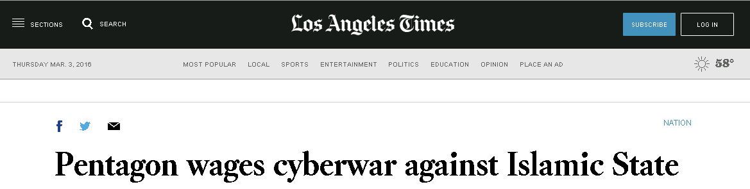
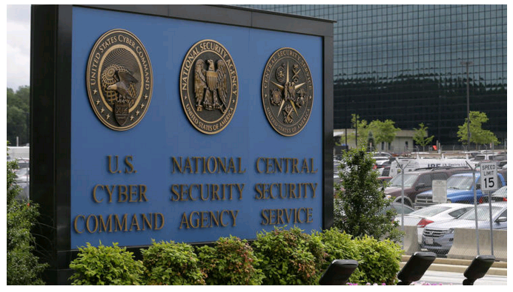
Pentagon v DAESH (1)

Slide 77
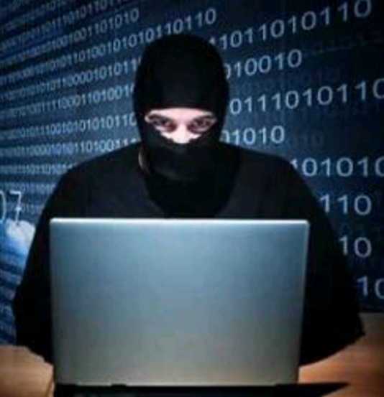
Pentagon v DAESH (2)
2016-02-29
Cyberoffensive launched vs ISIS
Military hackers attacked computer/cellphone networks
Launched from Ft Mead, MD
Overload enemy networks
  Interrupt C2 of forces w/ DoS
  Cannot just blanket entire area – need INTEL
Block ISIS PSYOP
  Email
  Social media

Slide 78
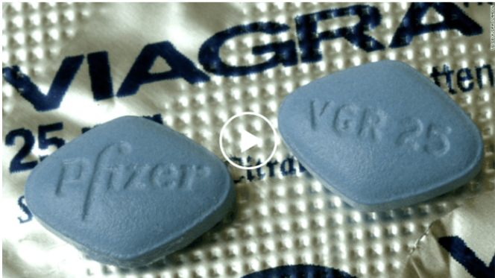
Hackers v DAESH
Griffin, A. (2015-11-27). “Anonymous has taken down an ISIS website and replaced it with an ad for Viagra.” Business Insider.
< http://tinyurl.com/j2fkf7v >
GhostSec affiliate
Click through to
pharmacy site
Buy Viagra and Prozac
PSYOP to make
candidates laugh at ISIS

Slide 79
DISCUSSION:
What are the most effective measures for defending against cyberwarfare attacks?
Are kinetic (conventional) warfare methods adequate / appropriate for reducing cyberattacks?
How do we cope with the risk of attacking the wrong targets?

Slide 80
Part 4:
Cyberdefense Policy Issues

Slide 81
Part 4: Cyberdefense Policy Issues
Legal Defenses
Technical Defenses
Cooperative Efforts
US Military Policies
US Foreign Policy

Slide 82
Legal Defenses
International legal system ineffective vs infowar
  Information warfare not prohibited under UN charter (except if it causes death or property damage)
  Little or no police power to enforce few laws that exist governing infowar
  Sovereignty trumps law in cross-border communications
  No major powers have pressed to international laws or treaties to govern infowar
  Politics may override legal judgement
  Power of criminals supersedes legal systems
  Identifying source of attacks difficult
  Technology advances faster than laws
Not likely to see legal defenses used against cyberattack

Slide 83
Technical Defenses
All the technical defenses used in protecting computers and networks against individual attack can be used in cyberdefense
Entire contents of CSH6 apply to cyberwarfare defense
Constant attention to evolving vulnerabilities and threats
Special value for INTEL and COINTEL activities
  Intelligence to track state and non-state actors e.g., infiltration, monitoring Internet chatter
  Counterintelligence to identify spies and saboteurs

Slide 84

Cooperative Efforts
Little evidence of international cooperation to fight cyberterrorism or limit cyberwarfare
Strong efforts by US military to
increase cyberwarfare capabilities
NATO starting to act
  Signed agreements for coop’n
  NATO supporting Cooperative
  Cyber Defence Centre of
  Excellence in Estonia
EU supporting civilian cyberspace
programs
Robinson, N. (2013). “Cybersecurity Strategies Raise Hopes of International Cooperation.” RAND Corporation. < http://tinyurl.com/jfvc9g7 >

Slide 85
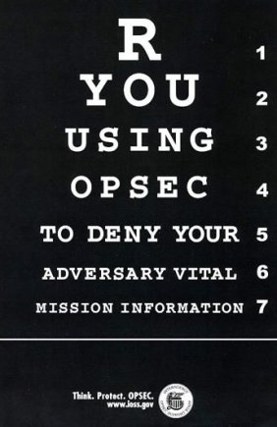
US Military Policies (1)
Joint Doctrine for Operations Security
  OPSEC
  Identify critical information
  Analyze visibility to adversaries
  Identify tactical and strategic
  advantages to adversaries of
  data acquisition
  Identify & implement
  countermeasures
US Joint Chiefs of Staff (2006).
“Operations Security.”
Joint Publication 3-13.3.
< https://fas.org/irp/doddir/dod/jp3_13_3.pdf >

Slide 86
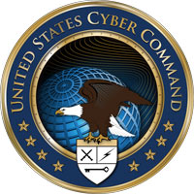
US Military Policies (2)
USCYBERCOM (US Cyber Command)
  2009-06-23 SecDef ordered
  creation
Mission
  Plan, coordinate,
  integrate synchronize,
  conduct
  Operations/defense
  DoD info networks
  Prepare/conduct
  cyberwarfare

Slide 87
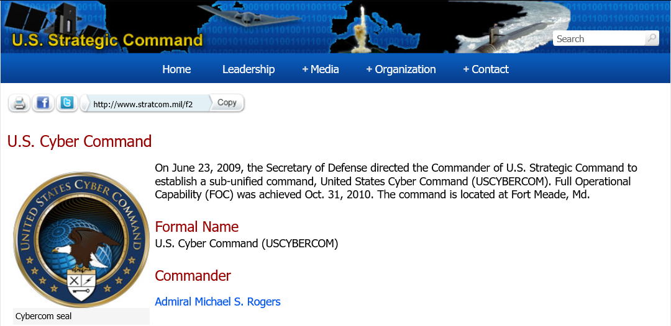
US Military Policies (3)
USCYBERCOM cont’d: Focus
  Defend DoDIN
  Support combatant commanders in action
  Strengthen US resistance & response to cyberattacks
https://www.stratcom.mil/factsheets/2/Cyber_Command/

Slide 88
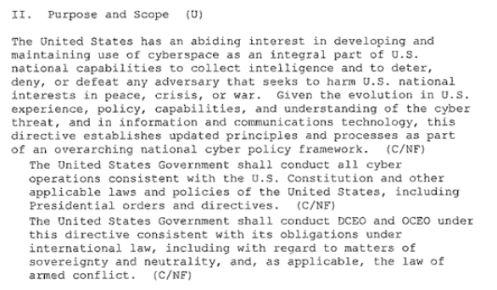
US Military Policies (4)
Presidential Policy Directive PPD-20 (2012-10)
leaked 2013-06-07
< http://tinyurl.com/hezjbs2 >

Slide 89
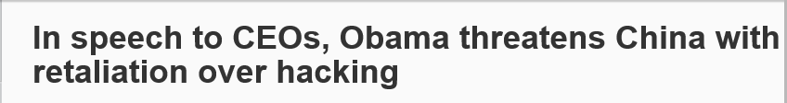
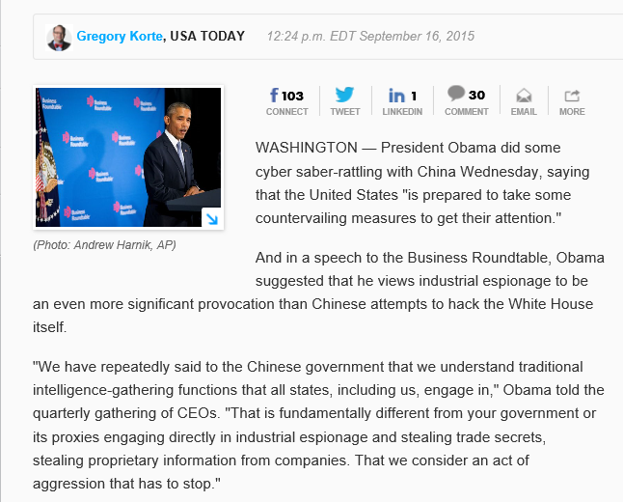
US Foreign Policy
http://tinyurl.com/npfoxh9

Slide 90
Part 5:
Emerging Vulnerabilities & Threats

Slide 91
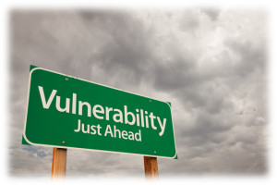
Part 5: Emerging Vulnerabilities & Threats
Internet of Things
Connected Automobiles
Self-Driving Cars
Industrial
Robots
Hospital
Systems

Slide 92
Internet of Things
Growing number of controls in homes & industry connected via unprotected Internet
2010 – STUXNET worm vs Iranian nuclear centrifuges
  US/Israeli cooperation
  Destroyed SCADA for SIEMENS centrifuges
Dec 2015 – networked toys usable as spying devices
Jan 2016 – NEST thermostats updated – stop working properly – cold homes
Jan 2016 – SHODAN search engine browses Webcams including in people’s houses
Feb 2016 – US Dir Natl Intel states that TV, car, & toys networked via Internet usable for surveillance

Slide 93
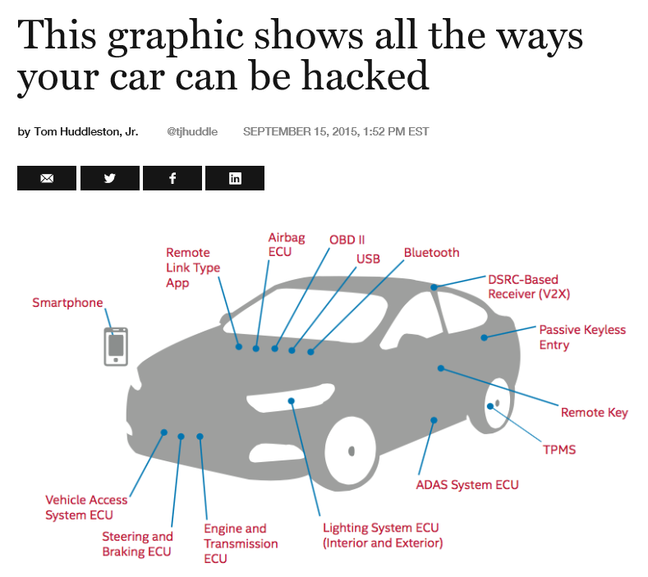
Connected Automobiles
http://fortune.com/2015/09/15/intel-car-hacking/

Slide 94
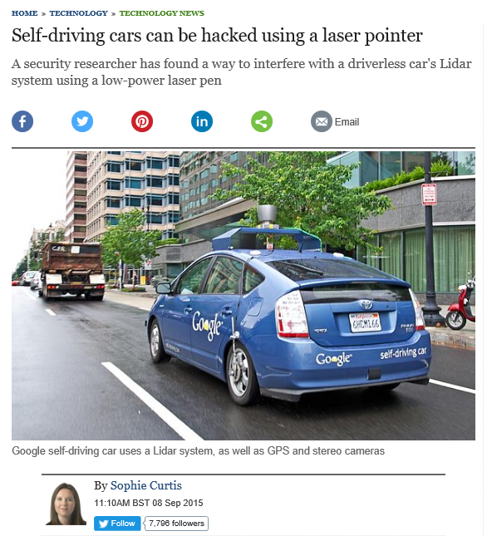
Self-Driving Cars (1)
Security Innovation researcher
Laser pointer scrambles LIDAR
Laser pointer tricks system into taking evasive action
http://tinyurl.com/qby7gok

Slide 95
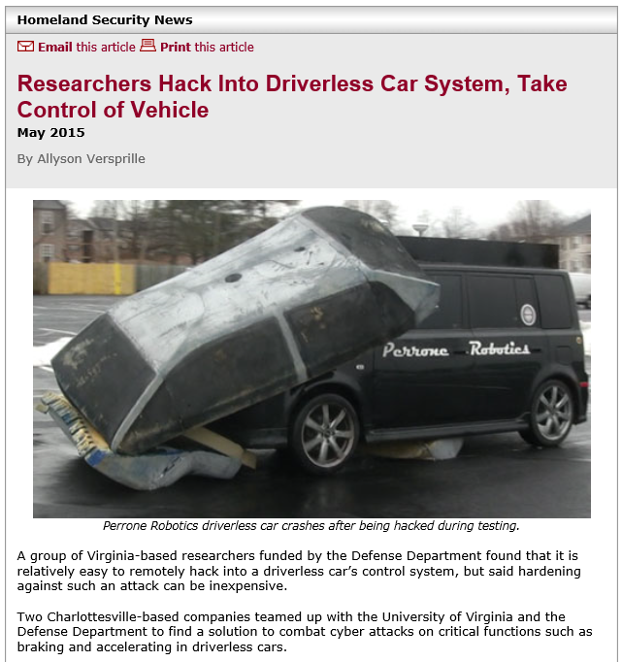
Self-Driving Cars (2)
http://tinyurl.com/ko6cuhy

Slide 96
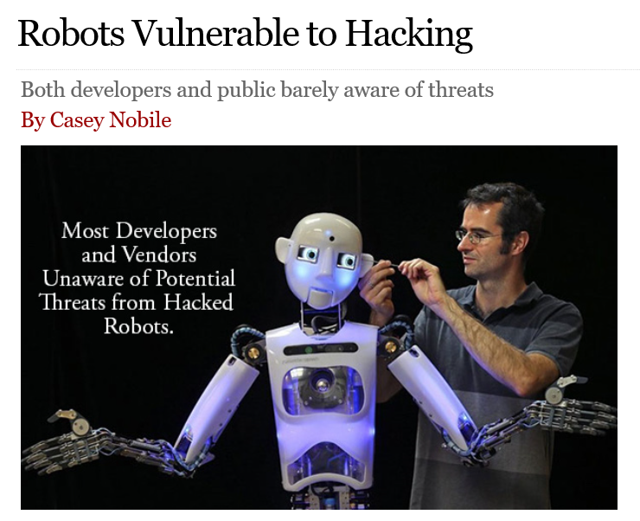
Industrial Robots
http://tinyurl.com/j7jg7w9

Slide 97
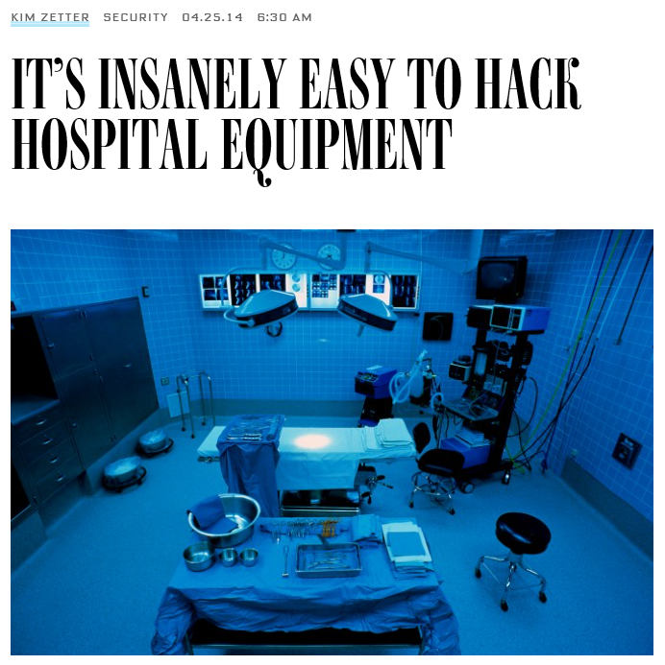
Hospital Systems
http://tinyurl.com/m2jarqo

Slide 98
DISCUSSION

Slide 99
Now go and study

