Slide 1
Cyberstalking & Cyberbullying
Our House Summit on Sexual Violence
2012-04-11
M. E. Kabay, PhD, CISSP-ISSMP
mailto:mekabay@gmail.com
V: 802.479.7937
Prof Information Assurance & Statistics
School of Business & Management

Slide 2
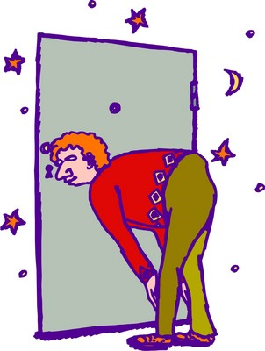
Topics
Cyberstalking
Jane Hitchcock
Choosing Victims
Targeting Victims
Cyberstalkers
Law Enforcement Response
Applicable Law
Prevention
Cyberbullying
Definition
Cases
Laws
Prosecutions
Prevention
Based on lecture notes for CJ341 – Cyberlaw & Cybercrime – Lecture #8

Slide 3
Cyberstalking
“Cyberstalking”
Relatively new term – since early 90s
Refers to harassment or physical threatening of a victim through electronic or digital means (Clifford)
Term sometimes used interchangeably with online harassment or online abuse
No uniform definition
Emerging crime
Originally considered harmless
CA first state to criminalize “stalking” behavior – after high profile events

Slide 4
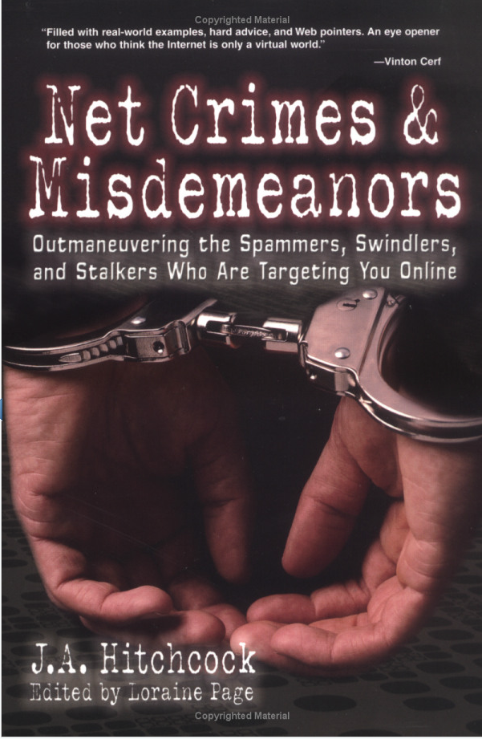
Jane Hitchcock
Literary agent & author
Victimized by mail-bombing (flooding) attack of her e-mail account
Targeted because of commentary she posted on a message board
After changing her e-mail address, harassment continued
Personal information posted on site
Listed as a sexual deviant
Looking to act out rape fantasies
Feared for her life

Slide 5
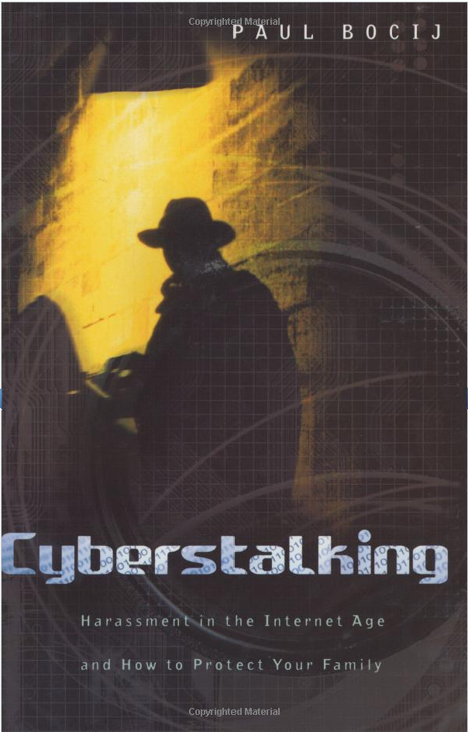
Cyberstalking
Continuous process
Not just one activity
Activities may cross into physical world
“Make no mistake: this kind of harassment can be as frightening and as real as being followed and watched in your neighborhood or in your home.”
Vice President Al Gore
http://tinyurl.com/3sue7kl

Slide 6
Choosing Victims
Accessibility
Cyberstalkers may not have to look far to locate personal / electronic contact information
Business cards
Personal Web sites
Google search
Myspace, Facebook
Easy to communicate electronically

Slide 7
Targeting Victims
Cyberstalkers Target Victims
E-mail
Online forums
Bulletin boards
Chat rooms
Spyware
Spam
Examples
Chat harassment /“flaming”
Unsolicited/unwanted e-mail
Tracing Internet activity
Sending viruses,
Sending obscene images

Slide 8
Tracking Down Cyberstalkers
Criminals take advantage of anonymity
E-mail forgery, spoofing, anonymous remailers
Fake registration information
But difficult to remain completely anonymous
Methods may delay identification
Cooperation of ISPs can help trace traffic using IP headers
Wiretaps can collect evidence if suspect identified
Forensic evidence lies on computer systems

Slide 9
Law Enforcement Response
Enactment of state statutes
Many states have added cyberstalking-specific legislation
Or amended pre-existing laws to address stalking via technology
Finite Resources of LEOs
$$
Time
Coordination / cooperation needed
Tracking across state lines
Jurisdictional issues
Search warrants, court orders

Slide 10
Applicable Law
No federal statute specifically directed at cyberstalkers
Statutes do exist to prosecute sending of obscene, abusive or harassing communications [46 USC § 223(a) – see next slide]
Patchwork application of state and/or federal law
State law varies from jurisdiction to jurisdiction
Some states have cyberstalking-specific statutes

Slide 11
Obscene, Abusive or Harassing Communications 46 USC § 223(a)
An offense to use a telecommunications device in interstate or foreign communications to:
make, create, solicit, and initiate transmission of any comment, request, suggestion, proposal, image, or other communication which is obscene, or child pornography, with intent to annoy, abuse, threaten, or harass
make, create, solicit, and initiate transmission of any comment, request, suggestion, proposal, image or other communication which is obscene or child pornography knowing recipient is under age 18, regardless of whether the maker initiated the communication

Slide 12
Obscene, Abusive or Harassing Communications (cont’d)
make telephone call or utilize telecommunications device, whether or not conversation or communication ensues, without disclosing identity and with intent to annoy, abuse, threaten, or harass;
make or cause the telephone of another repeatedly or continuously to ring, with intent to harass;
make repeated calls or initiate communication with a telecommunication device, solely to harass;
knowingly permit any telecommunications facility under his or her control to be used to commit any of the above activities
Penalties include fines, imprisonment up to 2 years or both

Slide 13
Corporate Cyberstalking
Corporate Cyberstalking: incidents that involve organizations – companies, government
46 USC § 223(b)
Federal crime to make an obscene or indecent communication for commercial purposes or to allow a telephone facility to be used for this purpose
Federal crime to use telephone to make an indecent communication for commercial purposes which is available to anyone under the age of 18 or to allow a telephone facility to be used for this purpose

Slide 14
Threats: 18 USC § 875
Federal crime to transmit in interstate or foreign commerce a communication:
Demanding a ransom for the release of a person;
Intending to extort money;
Threatening to injure a person;
Threatening to damage to property
Requires a threat (so may not always apply to cyberstalking)

Slide 15
Threats (2): U.S. v. Kammersell
10th Circuit Court
Defendant allegedly sent threatening communication from his computer to another
Could be prosecuted under the statute
Even though defendant and recipient in the same state
Jurisdictional element (Interstate commerce) satisfied
Message transmitted over interstate telephone lines & traveled through server located outside state

Slide 16
Threats (3): U.S. v. Alkhabaz
Defendant: Uof Michigan student
Used e-mail to communicate with friend
Much description of fantasized sexual violence against female classmate
Prosecuted for sending “threats” via interstate commerce
District court dismissed, finding e-mail was not “true threat” & thus protected speech
6th Circuit Court affirmed decision
Did not rise to level of threat

Slide 17
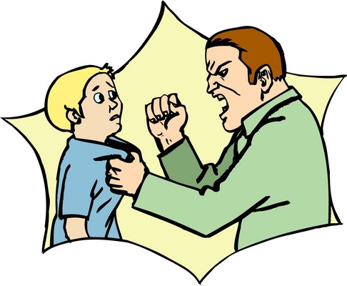
Stalking: 18 USC § 2261A
Federal crime to
Travel in interstate or foreign commerce with intent to kill, injure, harass, or intimidate another, placing that person in reasonable fear of death or serious bodily injury to themselves or to a family member; or
Use mail or any facility of interstate or foreign commerce to engage in a course of conduct that places a person in reasonable fear of death or serious bodily injury to themselves or to a family member
Key: Person must be placed in reasonable fear of death or bodily injury

Slide 18
Resources: Alexis A. Moore’s “Cyberstalking” series
What is cyberstalking?
When Stalking Goes Online - Examples of Cyberstalking
Cyberstalking and Women - Facts and Statistics
"I Was a Victim of Cyberstalking" - One Woman's Story
Cyberstalking, Spyware, and Privacy Protection
Cyberstalking and Your Credit Rating
What is Datafurnishing?
How Cyberstalkers Obtain Your Personal Information
12 Tips To Protect Yourself From Cyberstalking

Slide 19
12 Tips to Protect Yourself from Cyberstalking (Moore)*
Never reveal your home address.
Password protect all accounts
Conduct an Internet search using your name and phone number
Be suspicious of any incoming emails, telephone calls or texts asking for your identifying information
Never give out your Social Security Number
Utilize stat counters or other free registry counters that will record all incoming traffic to your blogs and Web sites
*With minor spelling and capitalization corrections

Slide 20
12 Tips to Protect Yourself from Cyberstalking (cont’d)
Check your credit report status regularly
If you are leaving a partner, spouse or boyfriend or girlfriend, reset every single password on all of your accounts to something they cannot guess
If you encounter something suspicious it could be a cyberstalker so act accordingly
If you think you’re a target, have your PC checked by a professional
If you think you have a cyberstalker, move fast
Get lots of emotional support to handle the cyberstalking period and to deal with the aftermath

Slide 21
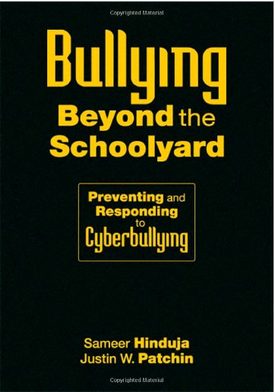
Cyberbullying

Slide 22
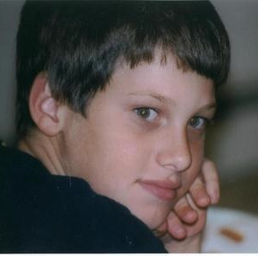
Ryan Halligan (2003)
13 year-old
Essex Junction, VT
Small, learning disability
Schoolmates tormented him using IM
Started 1999
Continued in middle school
Accused of being gay
Incessant threats, taunts & insults
Also bullied in “realspace”
Began corresponding with penpal about suicide
Hanged himself 2003-10-07 in bedroom

Slide 23
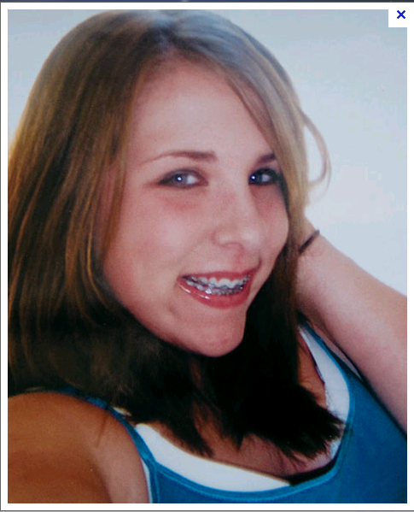
Megan Meier (2006)
“Josh Evans” became friends with child
Indicated fondness
Then wrote “The world would be better off without you”
Megan hanged herself 20 minutes later
Lori Drew (mom) & daughter created “Josh”
“Joke” after daughter stopped being friends
Mother charged 2008 but acquitted 2009
Megan Meier

Slide 24
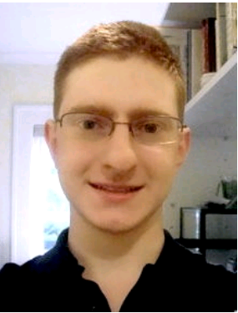
Tyler Clementi (2010)
Freshman at Rutgers University 2010
Roommate Dharun Ravi & his friend Molly Wei broadcast Clementi’s homosexual kiss in room
Ravi Twittered to 150 followers & e-mail to friends about encounter
Clementi jumped off GW Bridge 2010-09-22
Ravi convicted 2012-03-16 of 15 counts of invasion of privacy, witness tampering & evidence tampering + bias intimidation
Tyler Clementi

Slide 25
Prevention
STOP cyberbullying site
http://www.stopcyberbullying.org/index2.html
Sections for various ages:
7-10
11-13
14-17
Parents
Educators
Law enforcement

Slide 26
STOP cyberbullying site

Slide 27
Prevention
Foster awareness in children
Encourage communication with parents & teachers
Ensure positive support for children reporting bullying of all types including cyberbullying
Define rules explicitly for children
Consider putting computer into family-accessible room for younger children
Consider monitoring tools to check inbound and outbound messages
Use stories that teach morals
Be sensitive to children’s mood changes
Educate children in school for awareness of issues and where to get help
Stay aware of trends and cases & apply lessons

Slide 28
DISCUSSION

