Slide 1
Using Outlook or Excel to Create a Weekly Course Schedule
M. E. Kabay, PhD, CISSP-ISSMP
Professor of Computer Information Systems
School of Business & Management
Norwich University Press F5 key to start narrated show.
Copyright © 2013 M. E. Kabay. All rights reserved.
Notes:
I was recently asked to show students (and maybe even faculty) how to use EXCEL to create a weekly calendar showing courses. This narrated PowerPoint presentation guides novices through the process. If you have never used EXCEL but know how to use OUTLOOK, you might be better off creating your calendar in OUTLOOK.

Slide 2
OUTLOOK
Notes:
So let’s start with OUTLOOK.

Slide 3
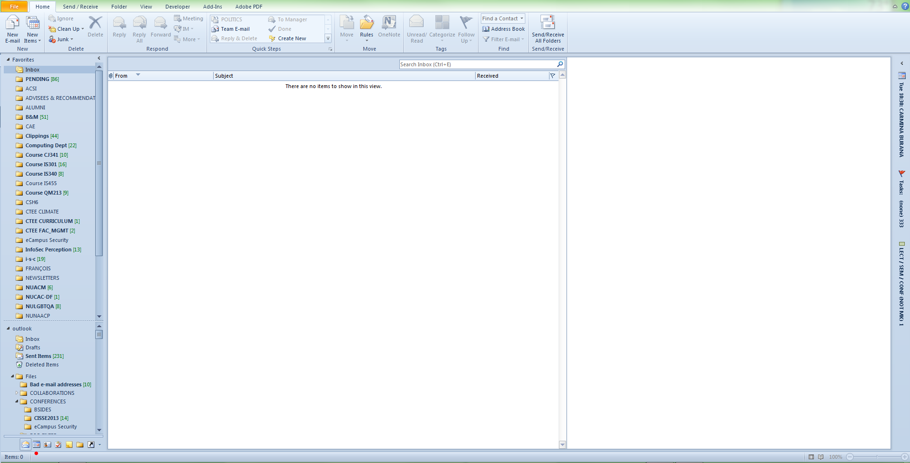
Notes:
Start by moving to the calendar view in Outlook. Here, I’ve put a red dot below the calendar icon in my bottom toolbar, but you may have a different preference for how to see your calendar.

Slide 4
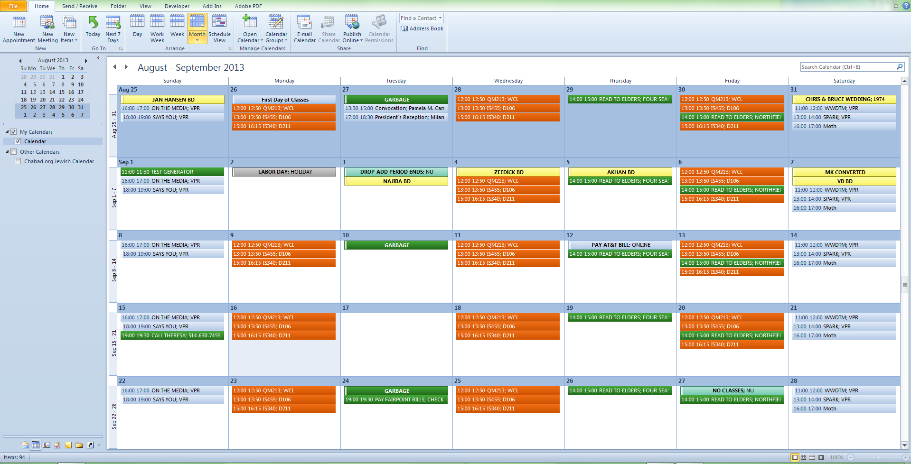
Notes:
This shows you a calendar with lots of appointments and courses already loaded. We’ll go through a step-by-step demonstration of how to add another class.

Slide 5
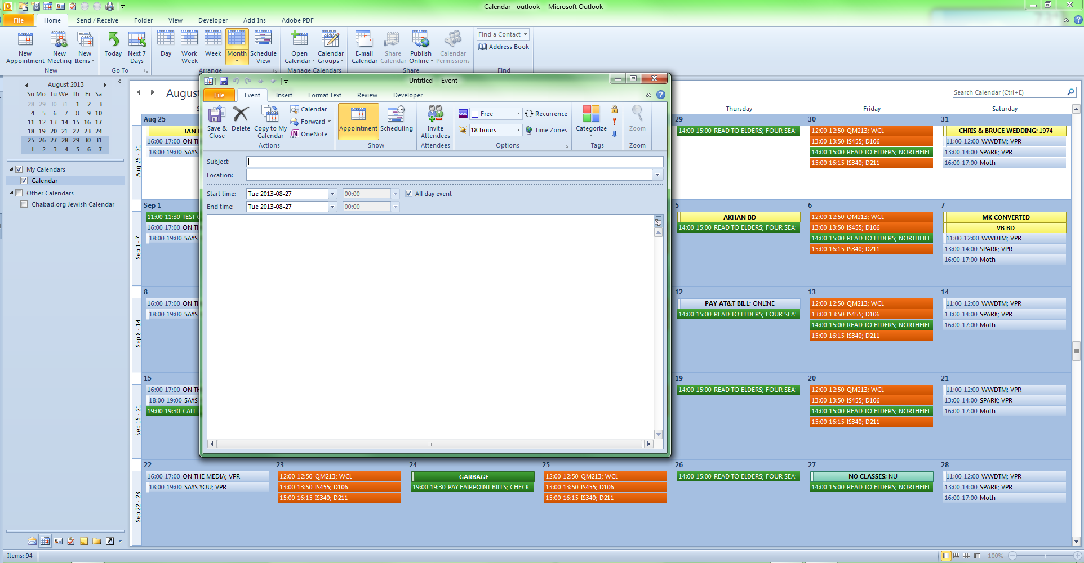
Notes:
Let’s suppose there’s a class you want to add (say, AB123 in D456) on Tuesday and Thursday mornings from 10:50 to 12:15. Start by double-clicking anywhere in the first Tuesday of the semester – here, the 27th of August. That brings up the event pop-up, as shown here.

Slide 6
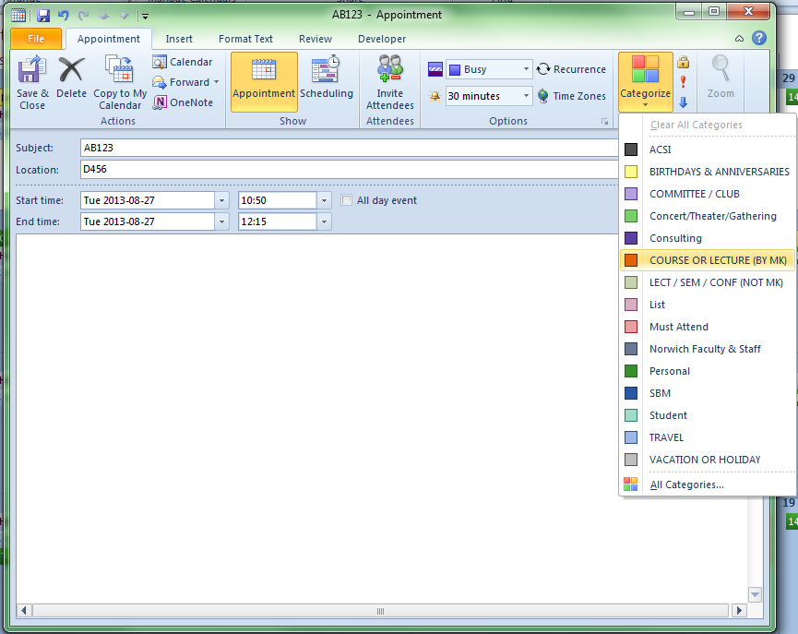
Notes:
Fill in the right times for start and end and set your preferred warning time (here, 30 minutes). If you use category colors, you can select the one(s) you wish to assign to this event. In this example, the chosen category is red.

Slide 7
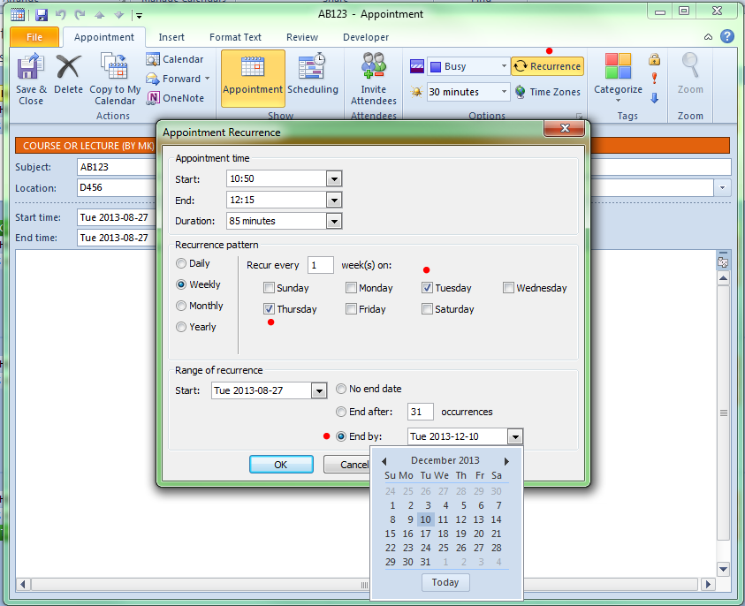
Notes:
In this case, the course runs on Tuesdays and Thursdays, so we can check the Thursday box as well as the Tuesday one which is already set. Since this course will go all semester, we can set the appropriate end date as shown.

Slide 8
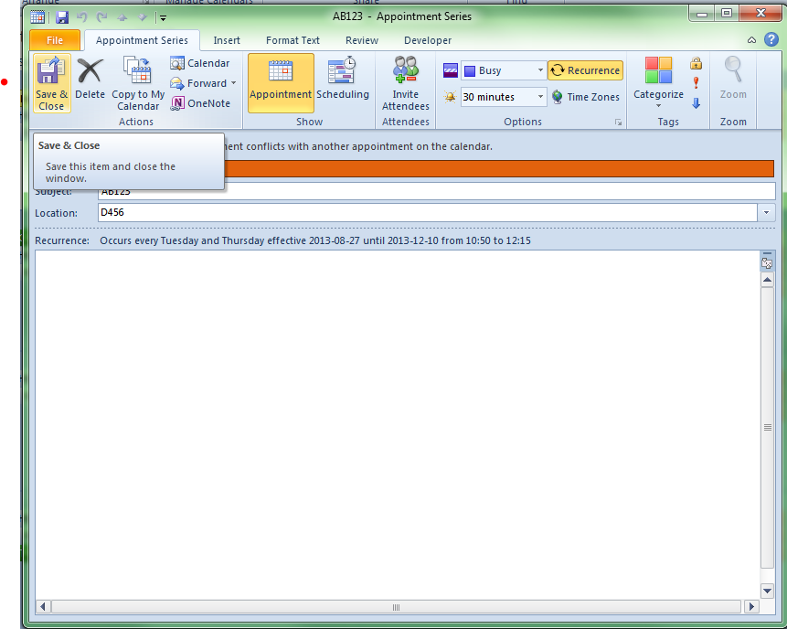
Notes:
You can Save & Close the appointments and they will show up throughout the semester.

Slide 9
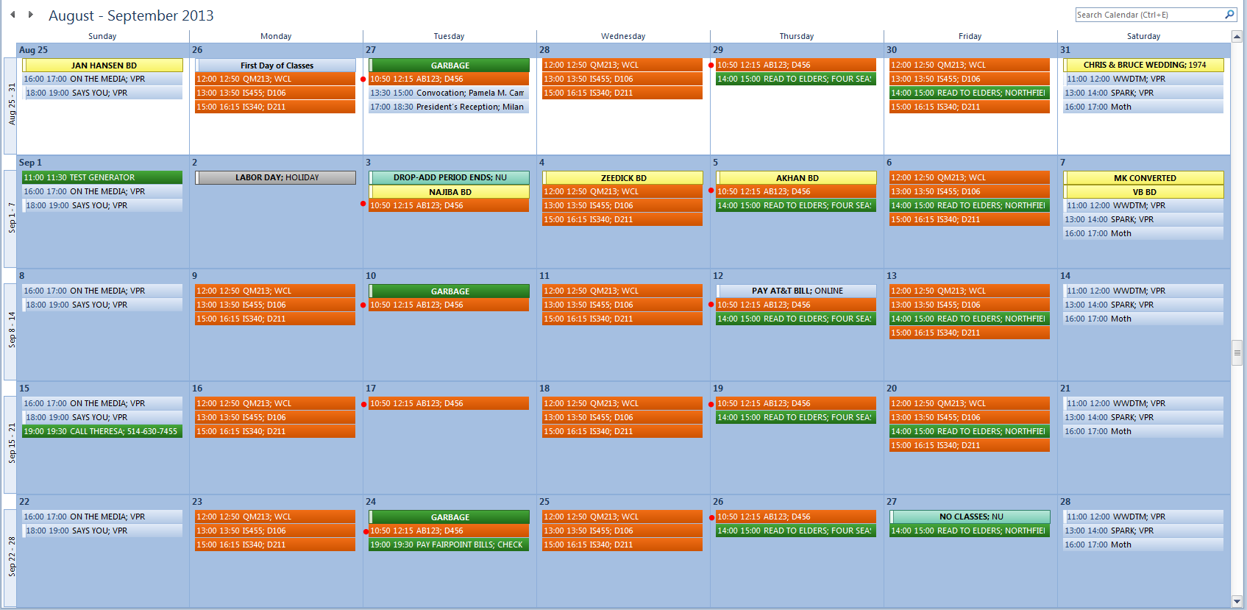
Notes:
You can see the series highlighted with (added) red dots on this screenshot.

Slide 10
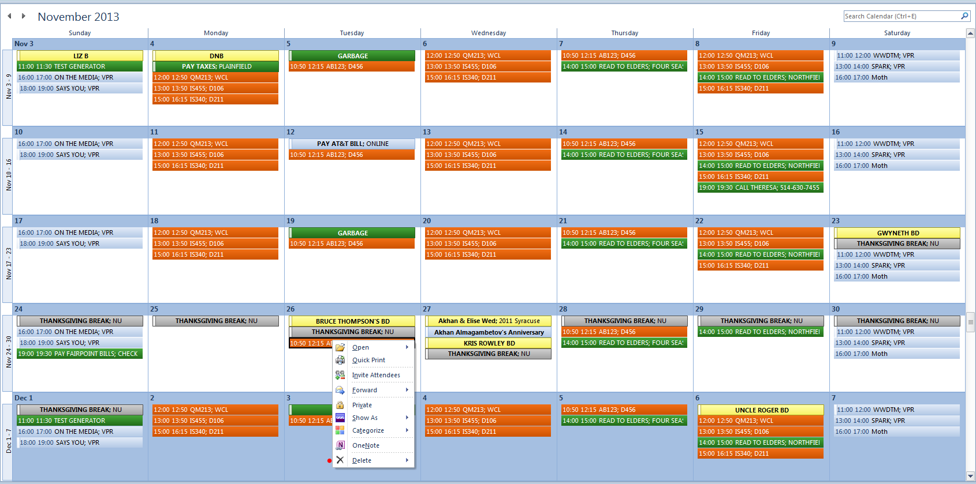
Notes:
What if you want to get rid of the class entries in your holidays? Here’s a picture of the November schedule with AB123 showing up during Thanksgiving break. Right-click on the class you want to delete and select Delete (at the bottom of the pop-up menu). Then left-click on Delete Occurrence to remove that particular entry. Do the same for the other one on Thursday. And you’re done! You can then add more classes to suit.

Slide 11
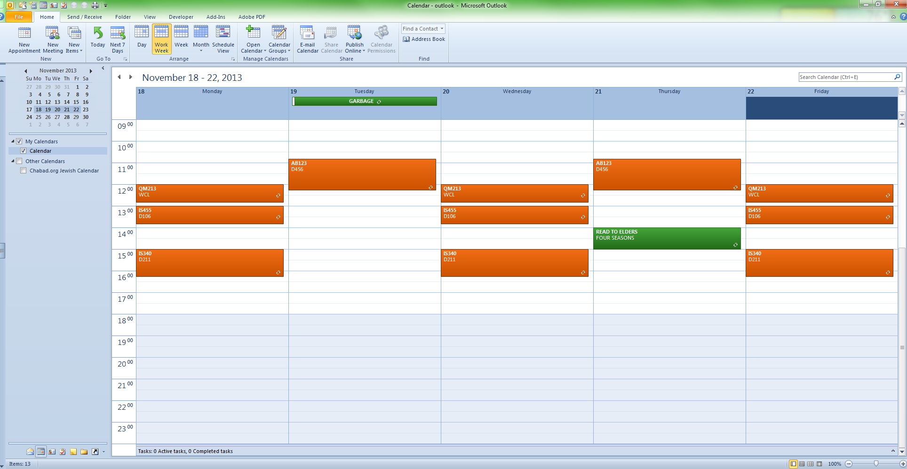
Notes:
Finally, if you prefer a different way of looking at your calendar, just choose one from your toolbar.

Slide 12
EXCEL
Notes:
Assuming you have used Excel enough to know how to select cells, the following tutorial guides you through the operations for using a Microsoft template designed for students.

Slide 13
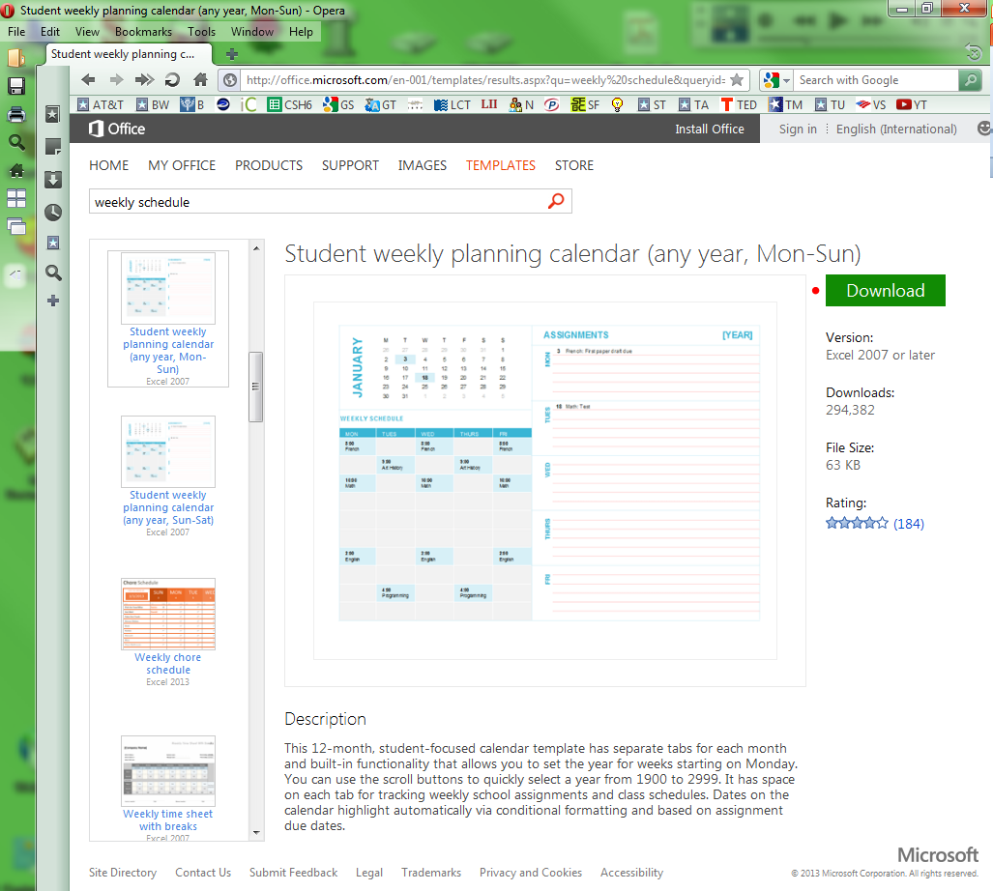
Notes:
The first thing you need is a template – a general format that’s already been prepared. Use the link shown at the top of the slide (tinyurl.com/mrrqu66) to locate a useful template on the Microsoft site. The actual link is so long I abbreviated it for you using the tinyurl service. Click on the download button (I added a little red dot on these screenshots to draw your attention to a specific feature) and save the file somewhere useful on your disk.

Slide 14
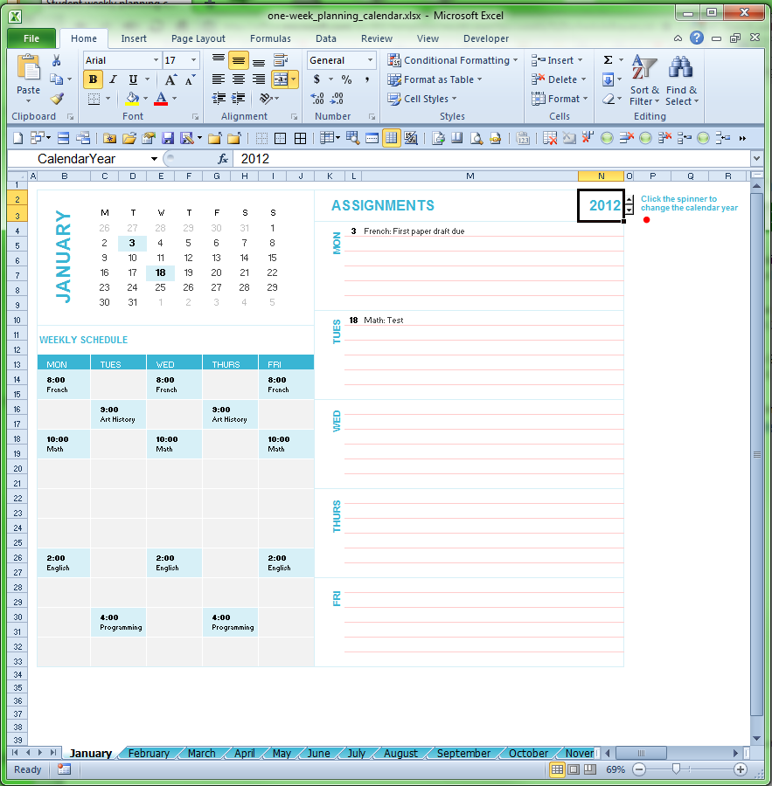
Notes:
Open the file you downloaded. Notice that the upper right corner lets you select your current year. Click the up arrow to select a later year.

Slide 15
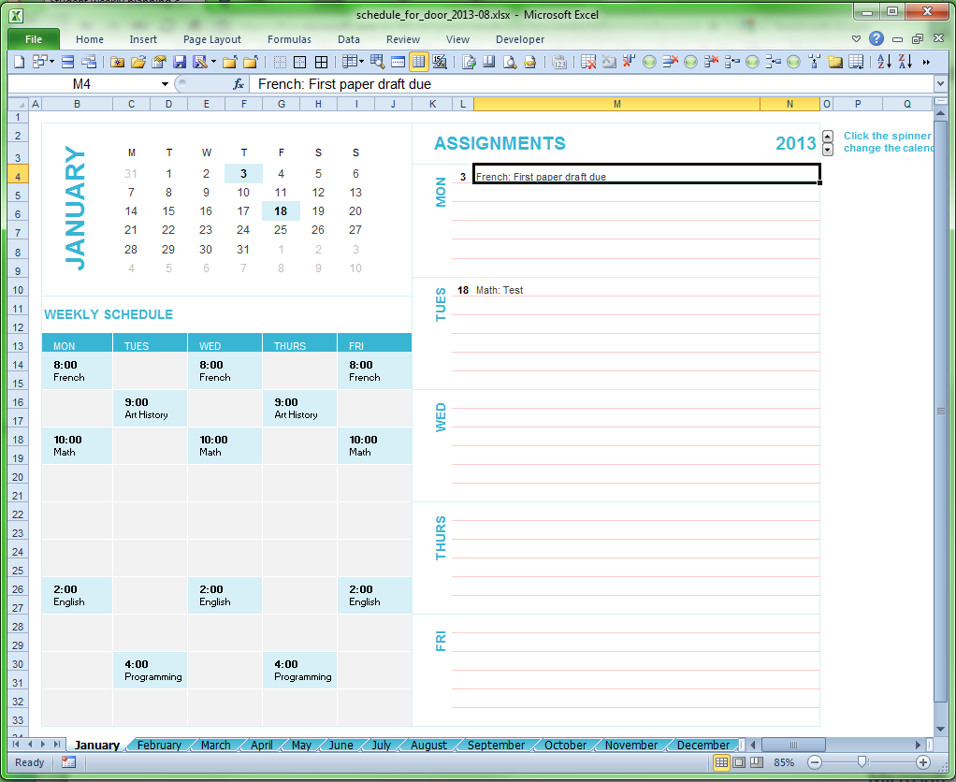
Notes:
OK, now we have the sample page from the JANUARY tab with the year 2013 selected for this example.

Slide 16
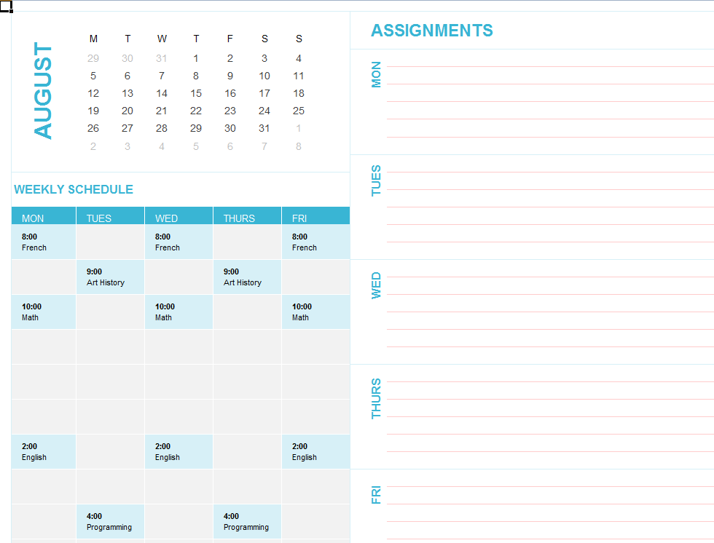
Notes:
Pick a month (in this case August) where you are going to create your own schedule.

Slide 17
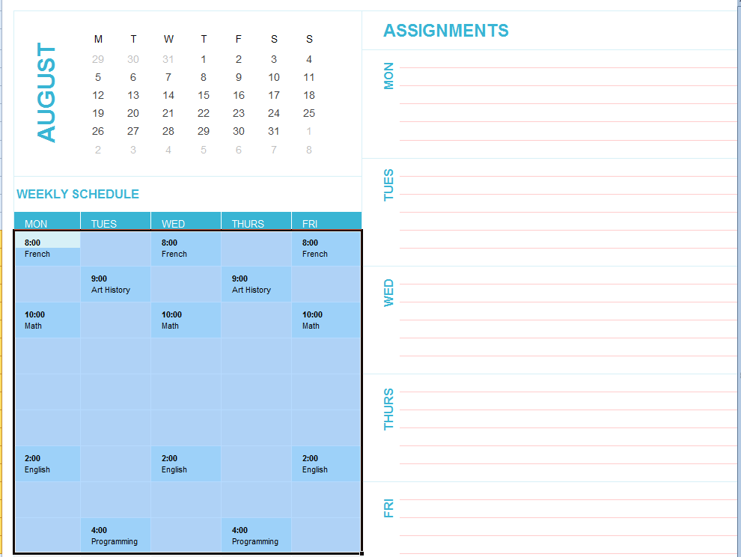
Notes:
Now let’s clear out the old stuff. Highlight the entire block of existing material using your trackball, mouse, or touchpad.

Slide 18
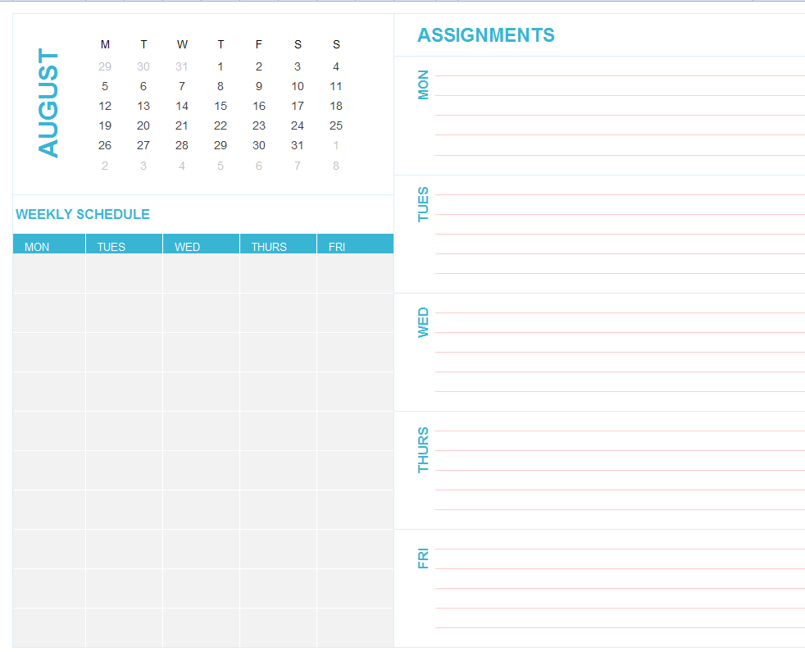
Notes:
Press delete and you have a nice empty set of blocks available.

Slide 19
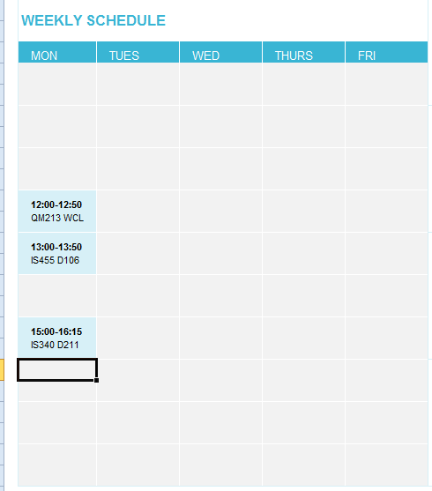
Notes:
You can pick a rectangle and start filling in the time and then, in the cell just below the time, a label for your activity. This example shows three courses.

Slide 20
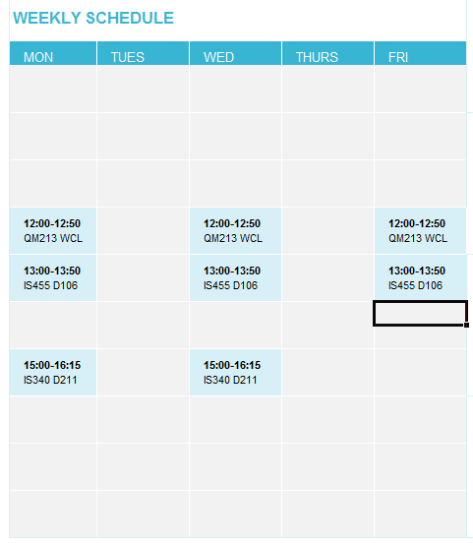
Notes:
Here’s an example with several days of courses shown.

Slide 21
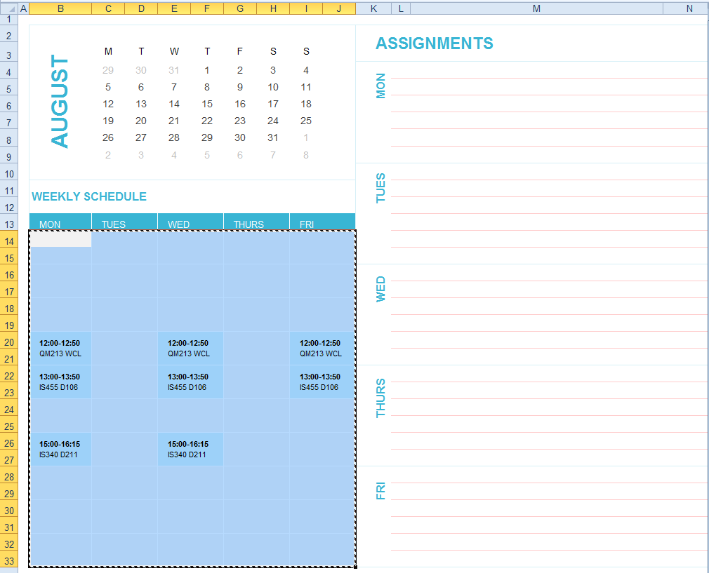
Notes:
Usually you can copy the schedule you’ve already created into the next month. Start by highlighting all your entries and pressing CTL-C (hold the control key down and touch C).

Slide 22
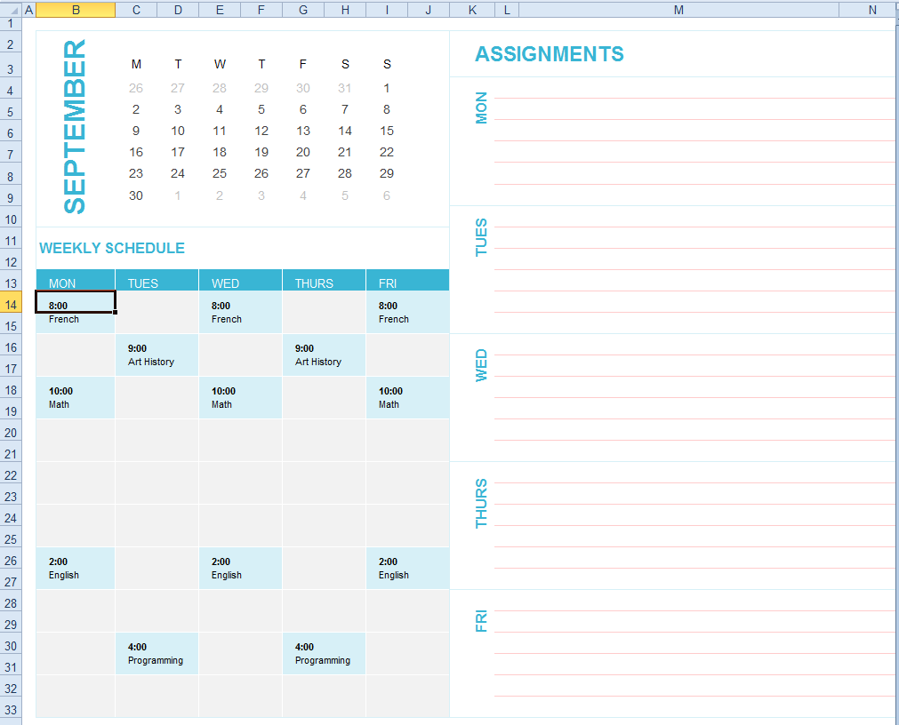
Notes:
Choose the next month (in this case September) where you would like to continue showing your schedule and place your cursor in the top left cell of that area.

Slide 23
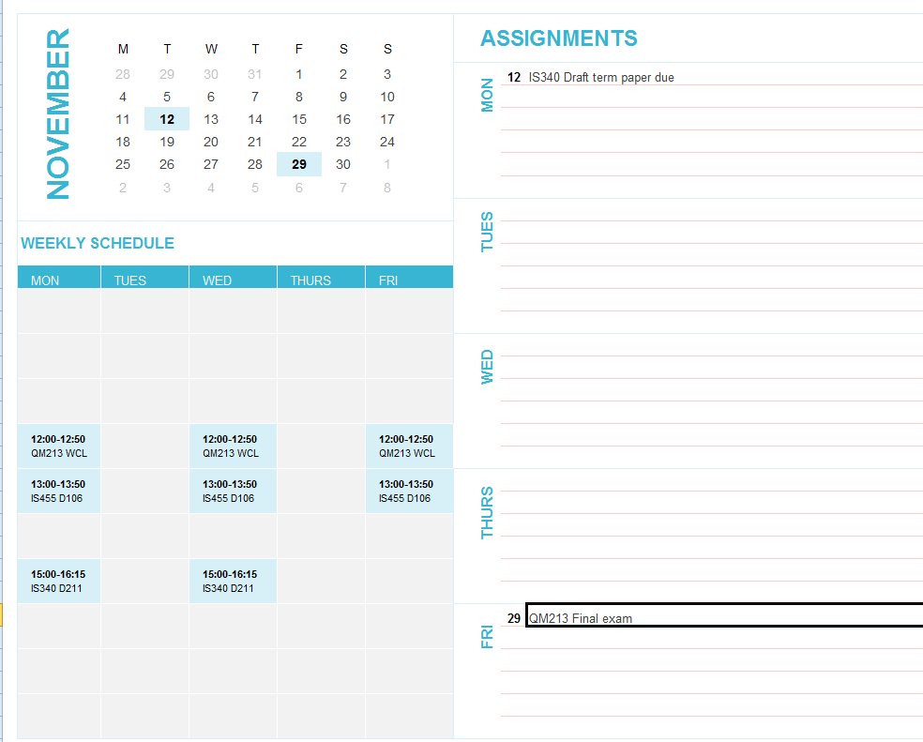
Notes:
Paste the previous month’s data into the calendar (CTL-V). You can then add whatever you like or remove things as needed. The ASSIGNMENTS column is available to you for noting the deadlines for all assignments.

Slide 24
Go to it!
Notes:
And that’s it! I hope you can use this information to ease your work.

