Slide 1

The Parkerian Hexad
MSIA GI512 Seminar 1 Week 9
Prof M. E. Kabay, PhD, CISSP-ISSMP
Assoc Prof Information Assurance School of Business & Management Norwich University
mekabay@gmail.com

Slide 2
Topics
The Classic Triad
The Parkerian Hexad
Confidentiality
Possession
Confidentiality & Possession Losses
Integrity
Authenticity
Integrity & Authenticity Losses
Availability
Utility
Availability & Utility Losses
Functions of IA Personnel

Slide 3
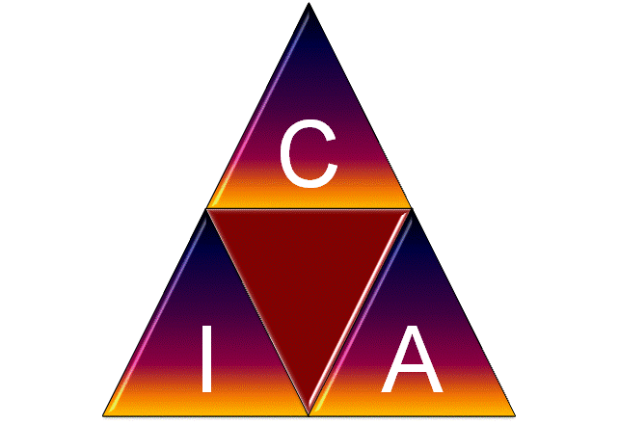
The Classic Triad

Slide 4

The Parkerian Hexad
Protect the 6 atomic elements of INFOSEC:
Confidentiality
Possession or control
Integrity
Authenticity
Availability
Utility

Slide 5
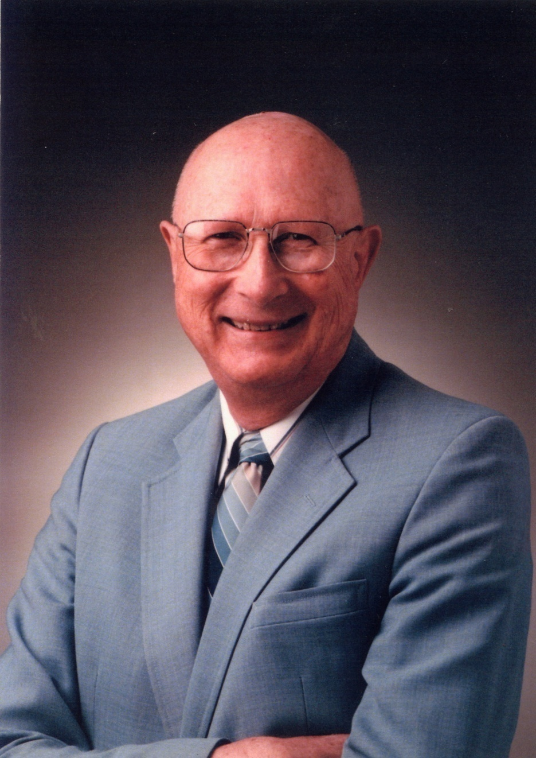
Why “Parkerian?”
Donn B. Parker, CISSP
MA (mathematics) UCAL Berkeley 1954
1992 Award for Outstanding Individual Achievement – Information Systems Security Association
1994 National Computer System Security Award –U.S. NIST/NCSC
The Aerospace Computer Security Associates 1994 Distinguished Lecturer award
MIS Training Institute Infosecurity News 1996 Lifetime Achievement Award
ISSA Hall of Fame 2000
SRI Intl Hall of Fame 2002
Fellow of ACM 2002
(ISC)2 Harold F. Tipton Lifetime Achievement Award
Notes:
Donn Parker
Donn B. Parker is a retired (1997) senior management consultant at SRI International in Menlo Park, California who has specialized in Information security and computer crime research for 30 of his 47 years in the computer field. He has written numerous books, papers, articles, and reports in his specialty based on interviews of over 200 computer criminals and reviews of the security of many large corporations.
He received the 1992 Award for Outstanding Individual Achievement from the Information Systems Security Association and the 1994 National Computer System Security Award from U.S. NIST/NCSC, The Aerospace Computer Security Associates 1994 Distinguished Lecturer award, and The MIS Training Institute Infosecurity News 1996 Lifetime Achievement Award. He was appointed to the Information Systems Security Association (ISSA) Hall of Fame in 1999.
The Information Security Magazine identified him as one of the five top Infosecurity Pioneers (1998). He formed the International Information Integrity Institute (I-4, < https://i4online.com/ >) at SRI in that has been serving over 75 large corporate members since 1986 to keep them aware of the most advanced information security concepts and controls.
* * *
Listen to (or watch) a 1 hour 49 minute audio conference on Early Computer Crime moderated by Donn Parker with pioneer researchers Whitfield Diffie (Sun Microsystems), John Markoff (The New York Times), Peter Neumann (Computer Science Lab at SRI) and Cliff Stoll (author of The Cuckoo’s Egg) recorded on 2000-03-27. See page
http://technetcast.ddj.com/tnc_program.html?program_id=79
for various audio and video streaming formats.

Slide 6
Confidentiality
Restricting access to data
Protecting against unauthorized disclosure of existence of data
E.g., allowing industrial spy to deduce nature of clientele by looking at directory names
Protecting against unauthorized disclosure of details of data
E.g., allowing 13-yr old girl to examine HIV+ records in Florida clinic
Notes:
1. The Canadian consumer-tracking service Air Miles inadvertently left 50,000 records of applicants for its loyalty program publicly accessible on their Web site for an undetermined length of time. The Web site was offline as of 21 January until the problem was fixed.
2. An error in the configuration or programming of the F. A. O. Schwarz Web site resulted paradoxically in weakening the security of transactions deliberately completed by FAX instead of through SSL. Customers who declined to send their credit-card numbers via SSL ended up having their personal details — address and so forth — stored in a Web page that could be accessed by anyone entering a URL with an appropriate (even if randomly chosen) numerical component.
3. Prof. Ross Anderson of Cambridge University analyzed requirements on the AMAZON.COM online bookstore for credit card number, password, and personal details such as phone number. He identified several risks: (1) merchant retention of credit card numbers poses a far higher risk of capture than of capture in transit; (2) adding a password increases the likelihood of compromise because so many naïve users choose bad passwords and then write them down; (3) even the British site for Amazon contravenes European rules on protecting consumer privacy; (3) such practices make it easier for banks to reject their clients' claims of fraudulent use of their credit-card numbers.

Slide 7

Possession or Control
Control over information
Preventing physical contact with data
E.g., case of thief who recorded ATM PINs by radio (but never looked at them)
Preventing copying or unauthorized use of intellectual property
E.g., violations by software pirates
Notes:
1. In Beijing, a court ordered two software pirates to compensate Microsoft for stealing their software and making illegal copies. This was the first case in which the Chinese justice system condemned miscreants for violations of intellectual property rights.
2. Hitachi, IBM, NEC, Pioneer and Sony (the ""Galaxy Group"") announced their agreement on a new digital watermark standard that would embed a cryptographic code in every frame of a digitial multimedia work. New digital equipment would not allow copies of such works."
3. The Norwegian company FAST makes software that can download MP3 files. The International Federation of the Phonographic Industry (IFPI) lodged a complaint that resulted in criminal prosecution of FAST for facilitating the theft of illegally posted copyrighted music from the Web. The IFPI was also contemplating a complaint against Lycos, whose search engine catalogs these illegal snippets of intellectual property.

Slide 8
Confidentiality & Possession Losses
Locating
Disclosing
Observing, monitoring, and acquiring
Copying
Taking or controlling
Claiming ownership or custodianship
Inferring
Exposing to all of the other losses
Endangering by exposing to any of the other losses
Failure to engage in or to allow any of the other losses to occur when instructed to do so

Slide 9

Integrity
Internal consistency, validity, fitness for use
Avoiding physical corruption
E.g., database pointers trashed or data garbled
Avoiding logical corruption
E.g., inconsistencies between order header total sale & sum of costs of details

Slide 10

Authenticity
Correspondence to intended meaning
Appropriate labeling or description of information
Avoiding nonsense
E.g., part number field actually contains cost
Avoiding fraud
E.g., sender’s name on e-mail is changed to someone else’s

Slide 11
Integrity & Authenticity Losses
Insertion, use, or production of false or unacceptable data
Modification, replacement, removal, appending, aggregating, separating, or reordering
Misrepresentation
Repudiation (rejecting as untrue)
Misuse or failure to use as required

Slide 12

Availability
Timely access to data
Defined for a specific context
May change over time (e.g., stock-market data)
Avoid delays
E.g., prevent system crashes & arrange for recovery plans
Ensure sufficient bandwidth for suitably fast data transmissions
Provide sufficient processing power for timely response to customers

Slide 13

Utility
Usefulness for specific purposes
Avoid conversion to less useful form
E.g., replacing dollar amounts by foreign currency equivalent by mistake
Showing salary in daily value instead of monthly total contrary to expectation
Prevent impenetrable coding
E.g., employee encrypts source code and "forgets" decryption key
Storing data in EBCDIC when equipment reads ASCII only

Slide 14
Availability & Utility Losses
Destruction , damage, or contamination
Denial, prolongation, acceleration, or delay in use or acquisition
Movement or misplacement
Conversion or obscuration

Slide 15
Functions of IA Personnel (1)
Avoidance: e.g., prevent vulnerabilities and exposures
Deterrence: make attack less likely
Detection: quickly spot attack
Prevention: prevent exploit
Mitigation: reduce damage
Transference: shift control for resolution

Slide 16
Functions of IA Personnel (2)
Investigation: characterize incident
Sanctions & rewards: punish guilty, encourage effective responders
Recovery: immediate response, repair
Correction: never again
Education: advance knowledge and teach others

Slide 17
Functions of IA Personnel (3)
Avoid
Deter
Educate
Detect
Correct
Prevent
Recover
Mitigate
Punish/reward
Transfer
Investigate

Slide 18
Now go and study

